Slide 1
Rechartering for 2022

Slide 2
Agenda
What’s New
Key Dates
Steps to a Successful & On-time Recharter
Review of UCRS
Recharter Turn-In

Slide 3
What’s New?
Membership Fee increase.
YPT each year

Slide 4
YPT
Each registered adult’s YPT Certificate must be valid for the entire membership term.
Longhorn Council will not complete a registration for those that doesn’t comply.

Slide 5
Online Recharter Payments
Payments can be sent directly to National Council with Recharter
CC or Electronic Check
Pay by Credit Card- 3% charge assessed
Pay by Electronic Check – $1.00 fee
LHC Accident Insurance will be configured and collected by National

Slide 6
New Member Coordinator
Every unit is encouraged to have a NMC
An NMC is a Member of the unit committee
Can count as one of the two minimum required committee members
NMC welcomes new youth and adults, makes them feel welcome and orients them to unit

Slide 7
Key Dates - 2021
YPT Mandatory Before Registration
15 Oct – Unit Charter Renewal System (UCRS) Open
12/14/2020 – Recharter Turn-in Party for Payments and Hard Copy Renewals
December 15- Due date- Please

Slide 8
Steps for Successful & On-time Recharter
Let LHC enter new members. Ensure all Youth and Adult applications turned in to BSA office before November 15 to have them on your roster.
Each adult is responsible for updating their personal information (e-mail addresses, contact info.) (my.scouting.org – Profile)
Begin collecting recharter & Boys’ Life fees.
Keep track of who’s paid, who’s not going to reregister, any position changes for next year.

Slide 9
Fees for 2020
Unit Liability Insurance fee $75.00
Individual member fee
(youth) $72.00
(All adults & Explorer youth) $45.00
Accident/Sickness Insurance fee
(each member) $15.00

Slide 10
Fees for 2020
Youth Joining Fee $25.00
(- New youth after August 1, 2020)
Boy’s Life subscription $12.00

Slide 11
Registration Fee Information
100% of the Recharter, Registration and Boys’ Life fees go to the National Council, BSA
The Longhorn Council incurs costs to process the fees for the National Council, BSA
Only the $15.00 Accident and Sickness Insurance fee for each person stays with the local council

Slide 12
Unit Charter Renewal System
Internet Rechartering Resources link: https://www.scouting.org/resources/internet-rechartering
Contains User Guide, FAQ and video
Log on to https://advancements.scouting.org/login

Slide 13
Use Google Chrome or Firefox or Internet Explorer 11
This site supports Chrome and Firefox and Internet Explorer 11 (without Compatibility View) with a minimum screen resolution of 800x600. This site requires JavaScript to be enabled for your browser.

Slide 14
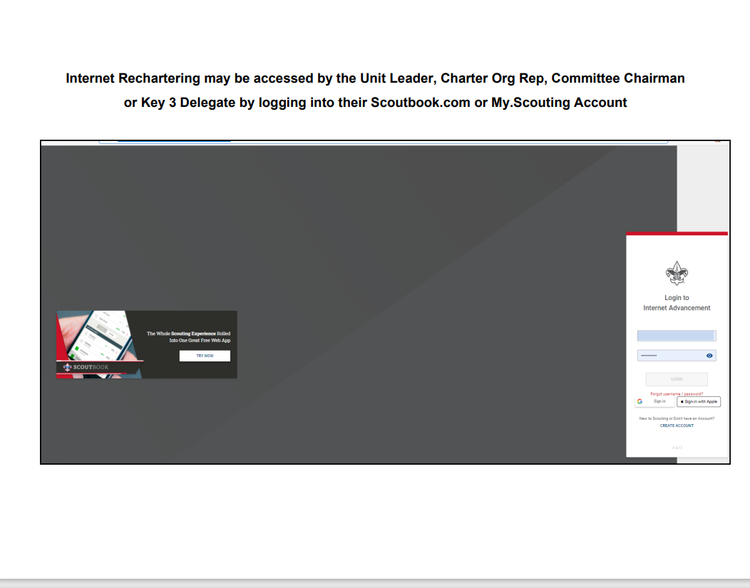

Slide 15
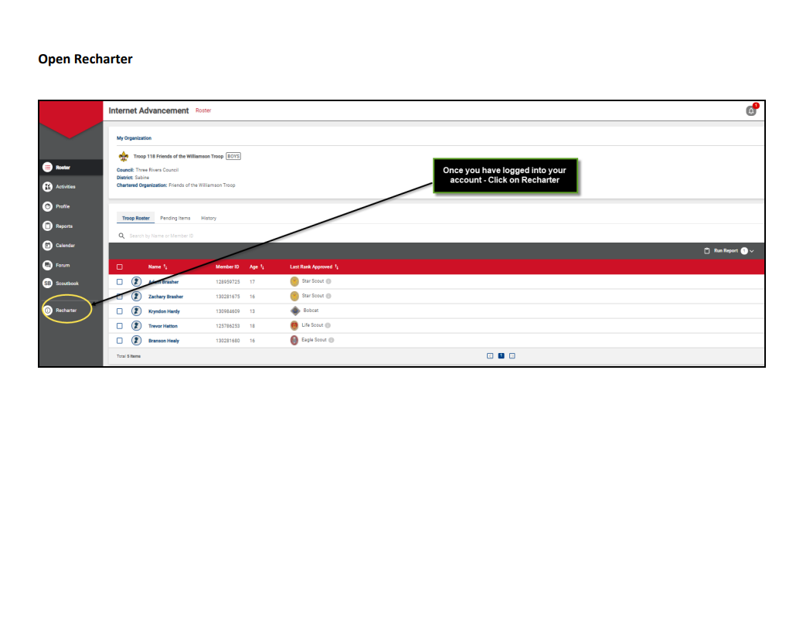

Slide 16
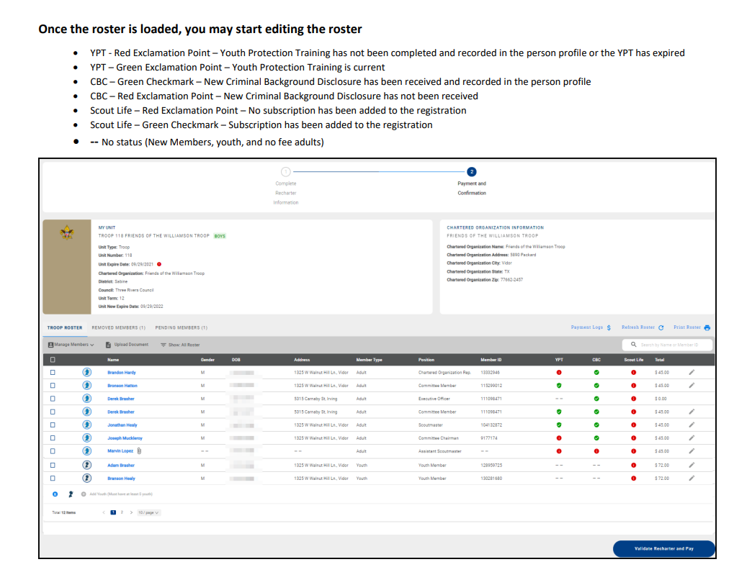

Slide 17
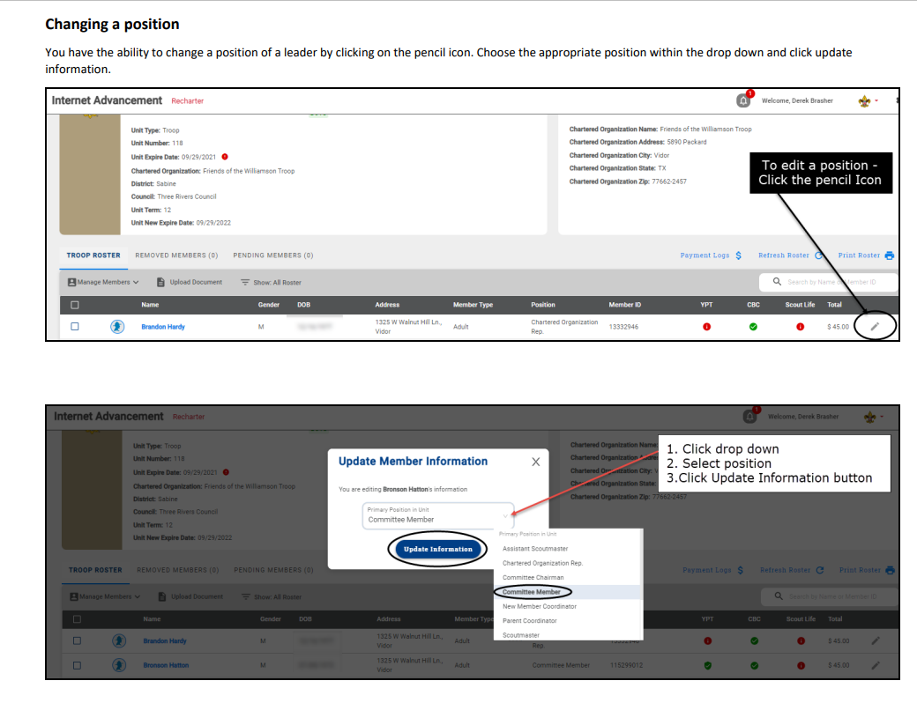

Slide 18
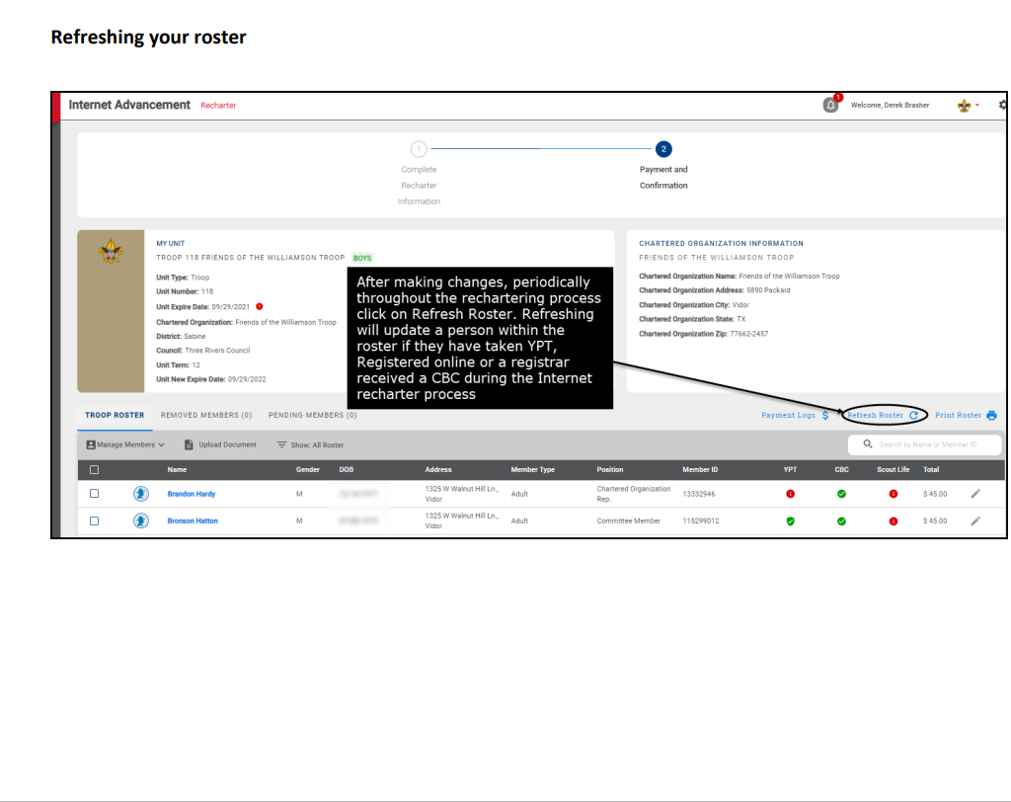

Slide 19
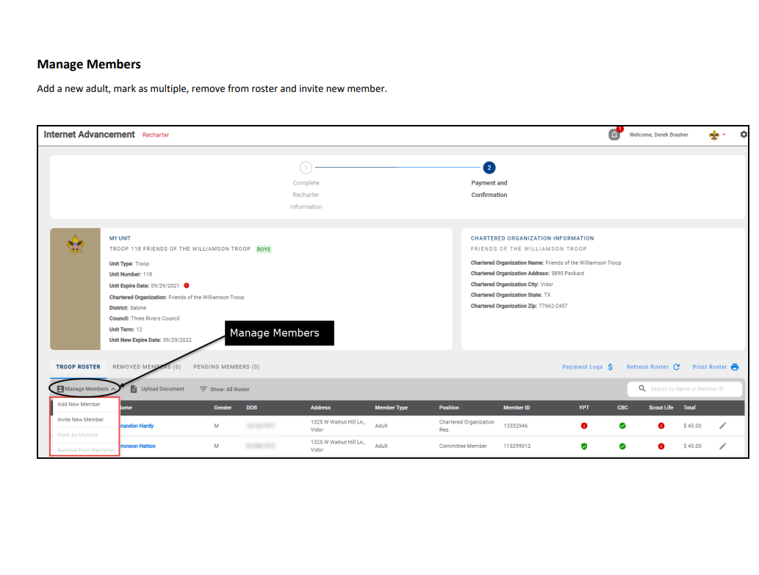
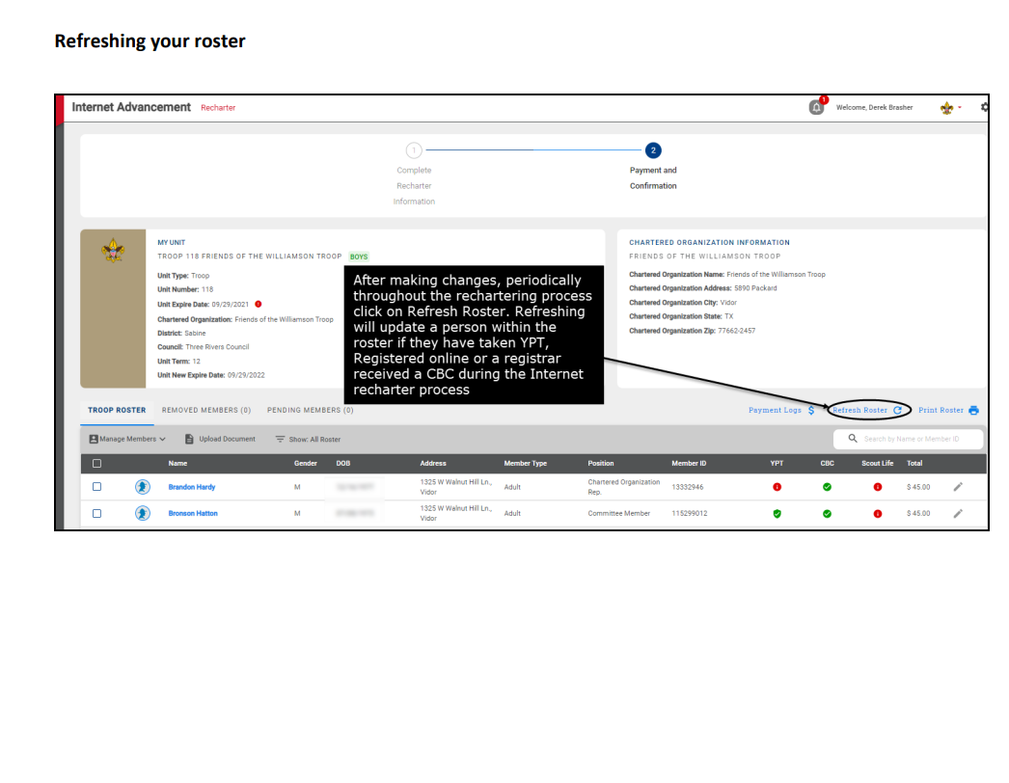

Slide 20
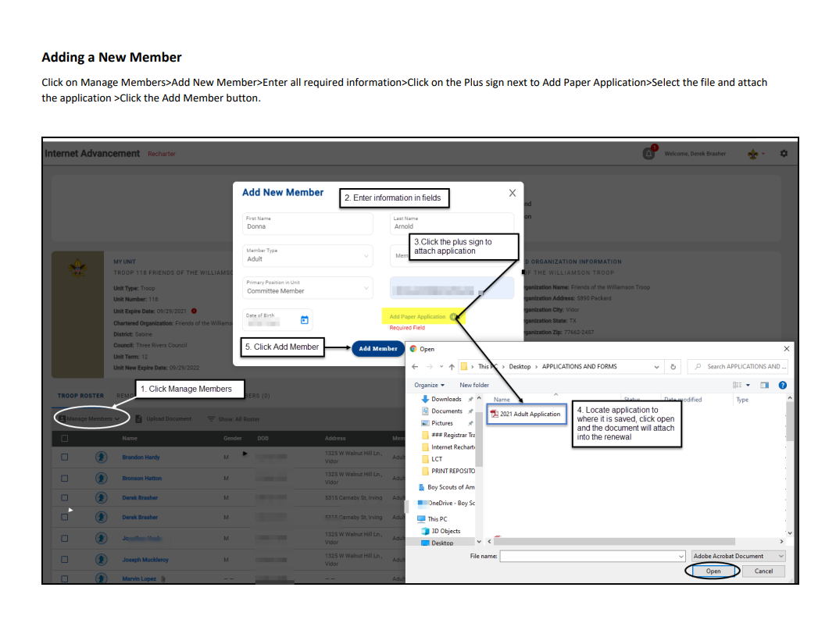

Slide 21
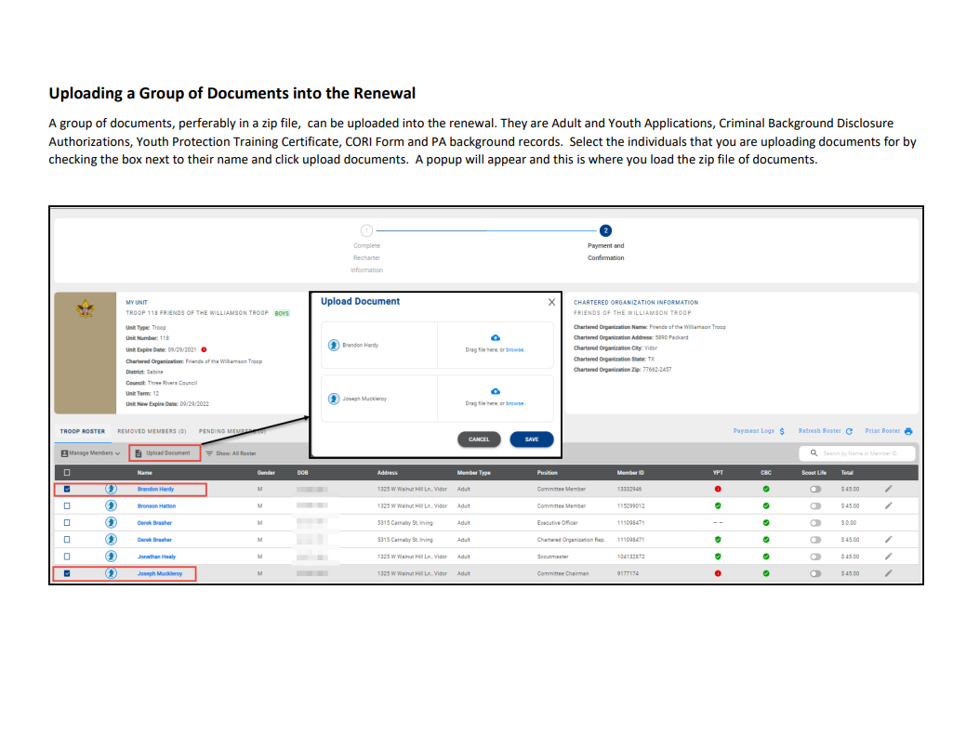

Slide 22
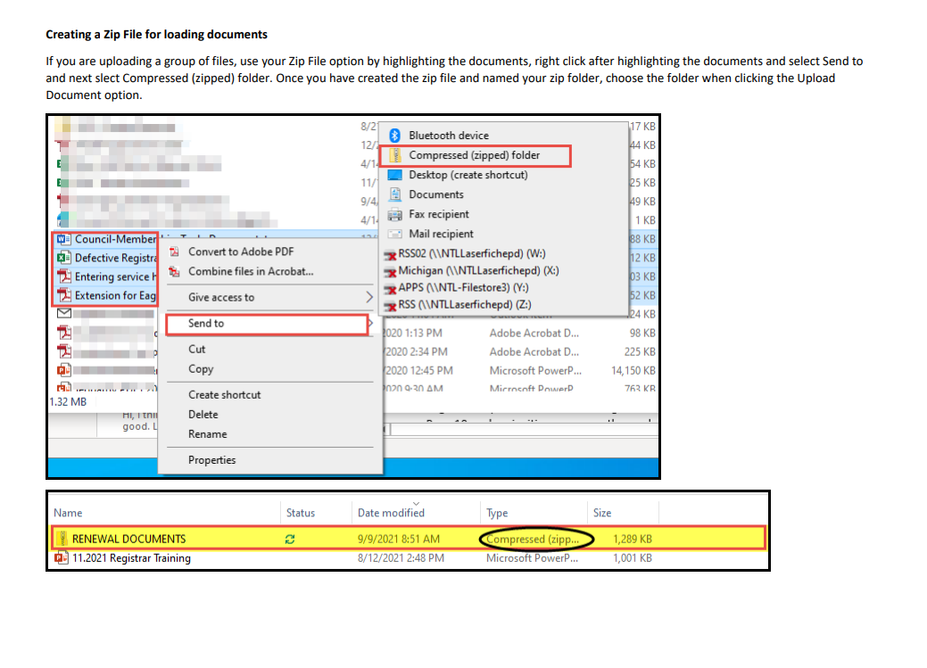

Slide 23
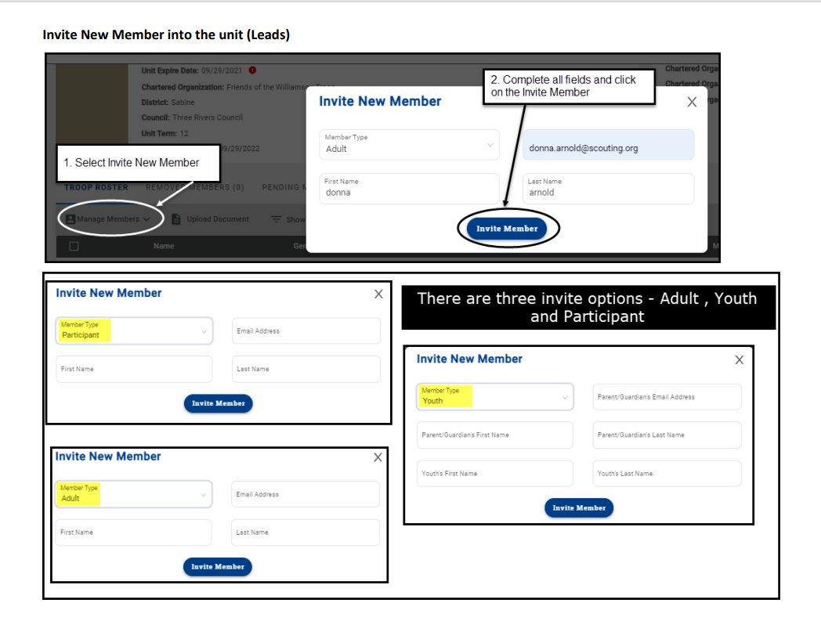

Slide 24
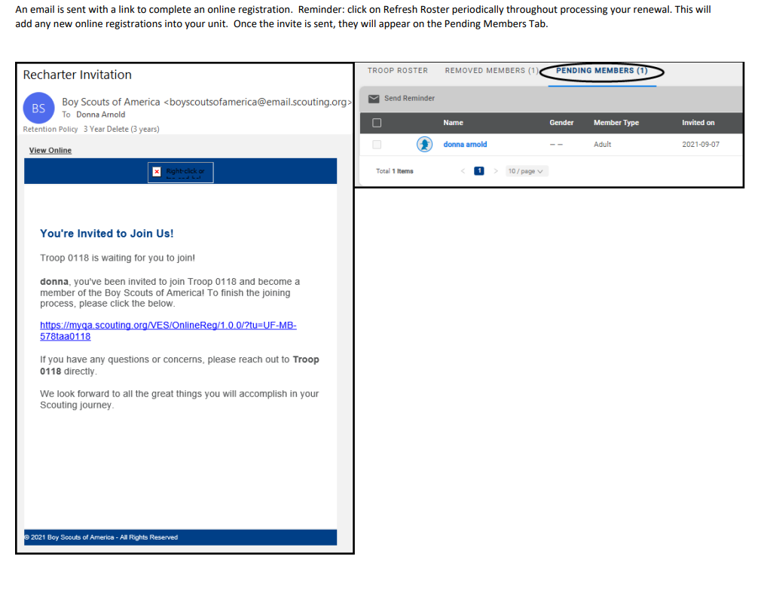

Slide 25
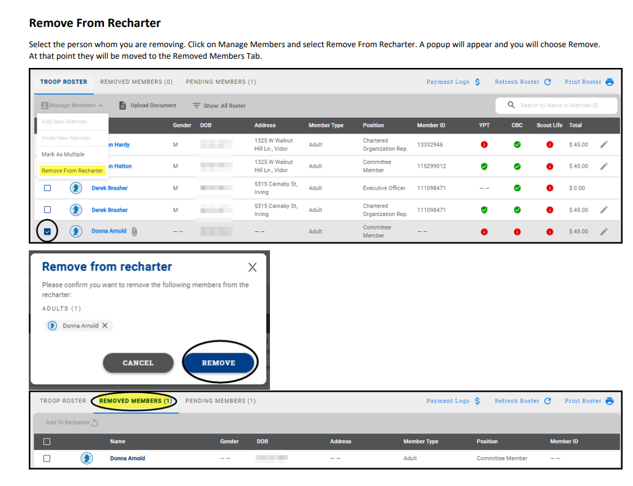

Slide 26
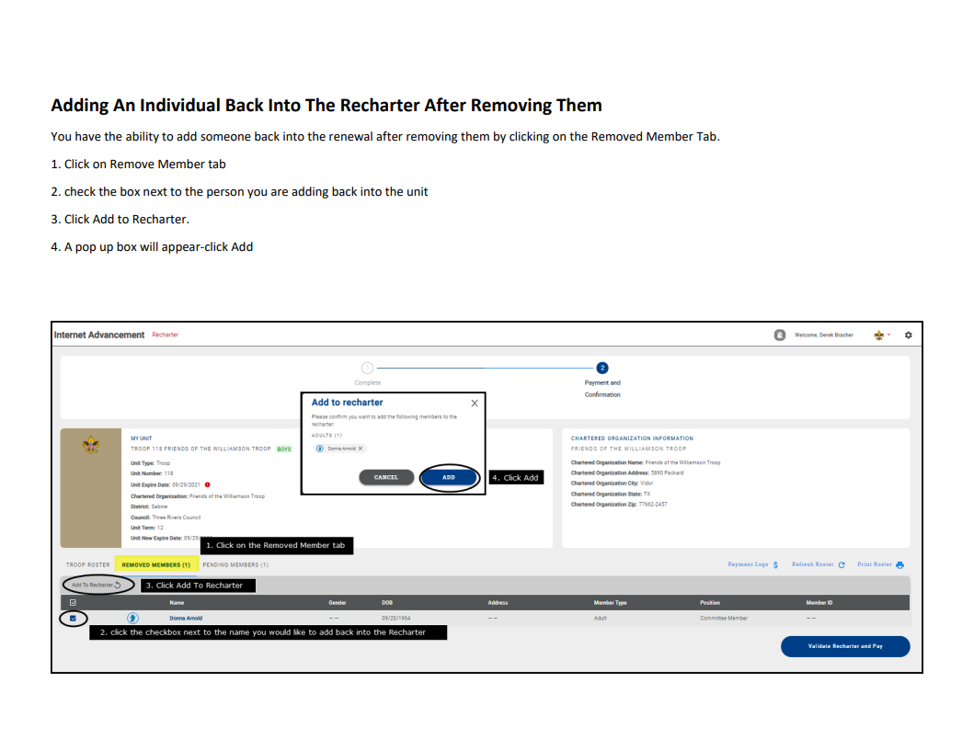

Slide 27
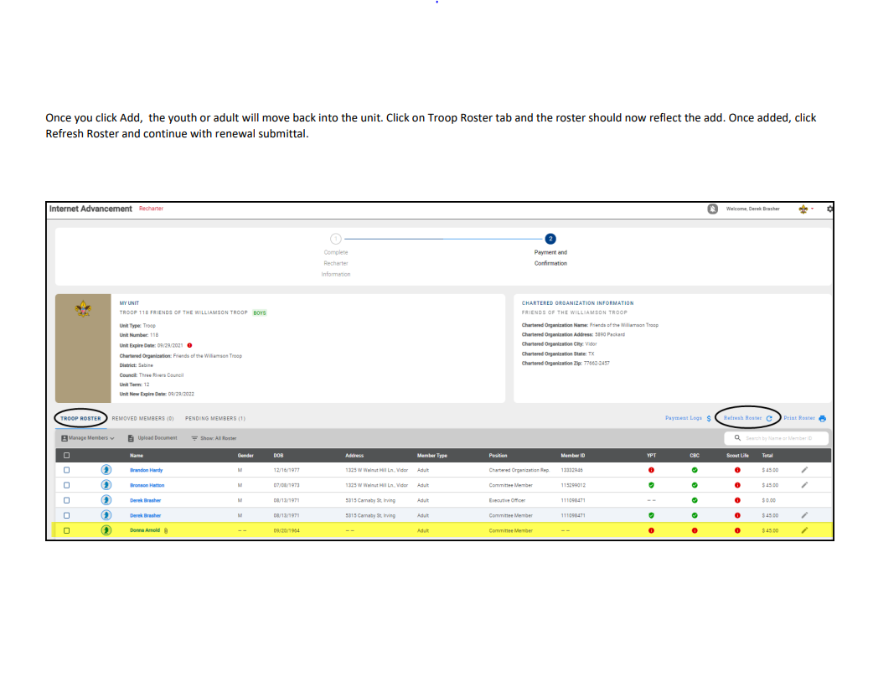

Slide 28
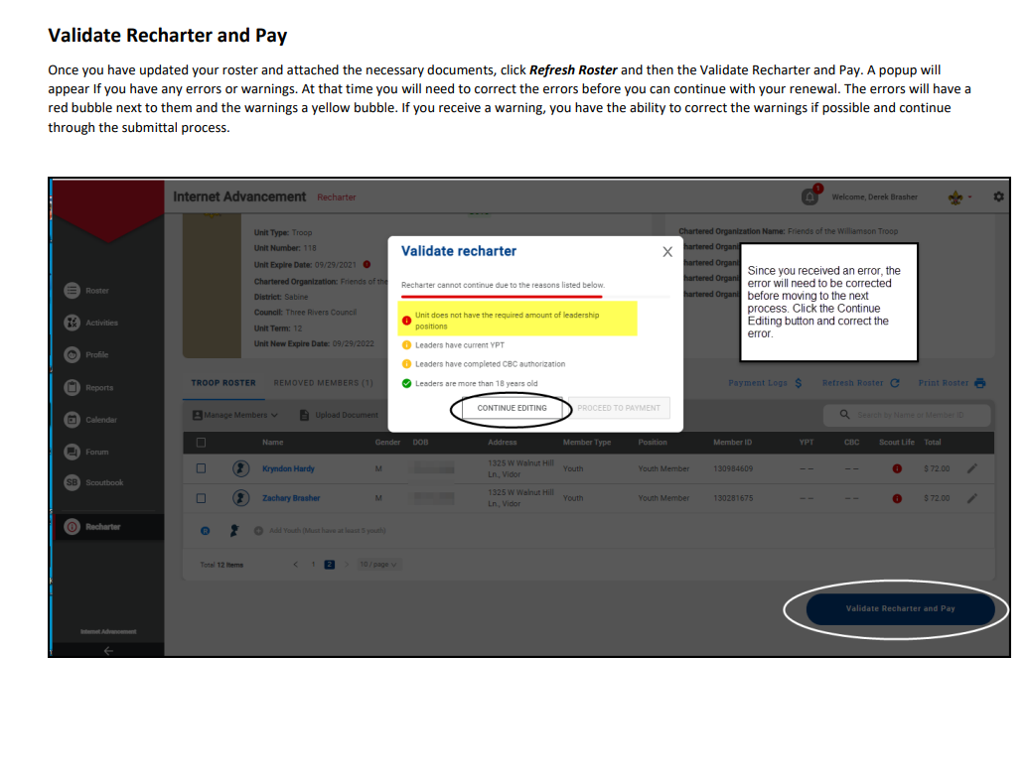

Slide 29
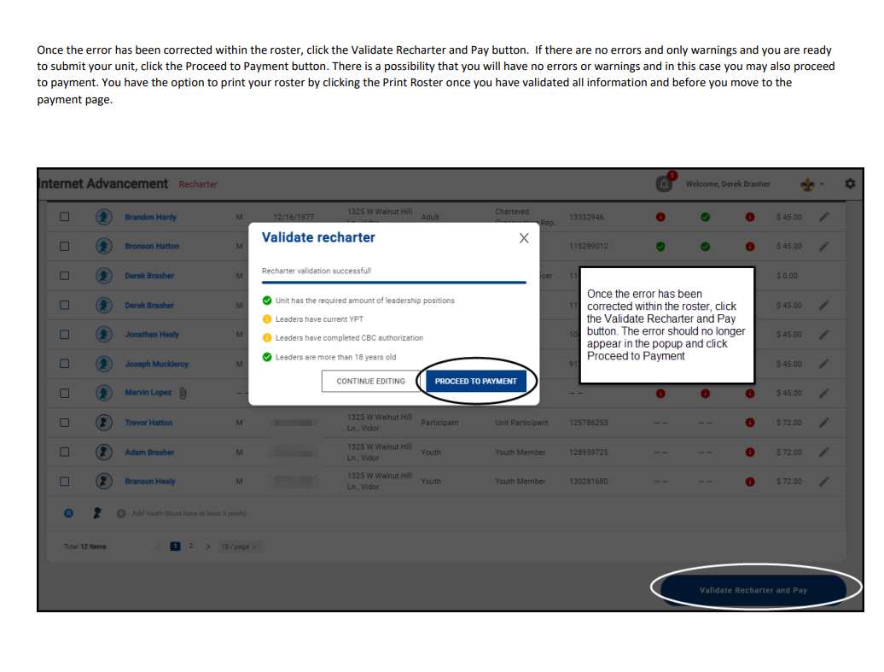

Slide 30
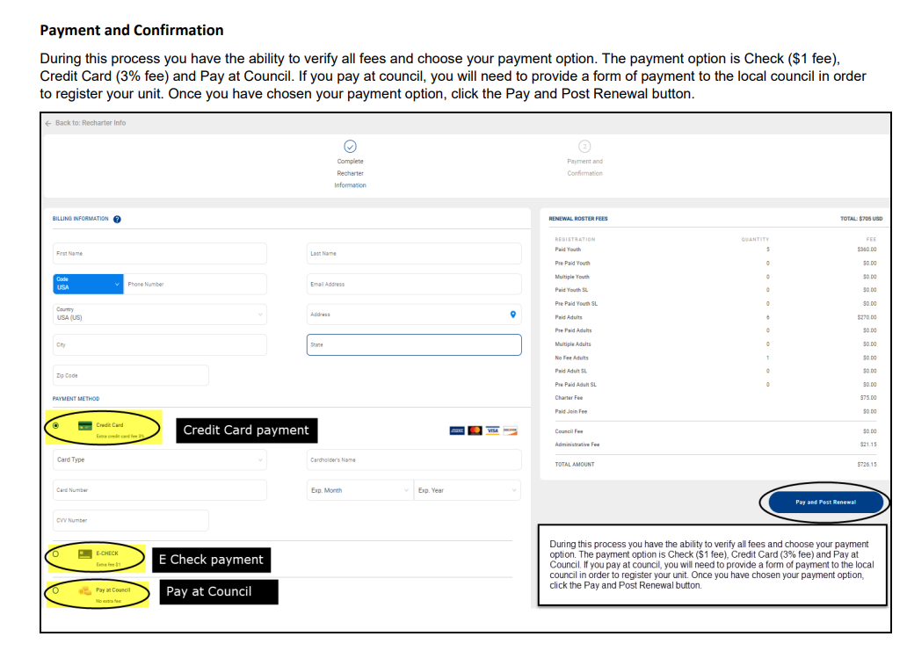

Slide 31
Recharter Turn-in 12/14/2020
Alert your Unit Commissioner that you sent your recharter on to National so that they don’t need to track you down
What to bring
JTE Unit Award Form
Family FOS Presentation Date

Slide 32
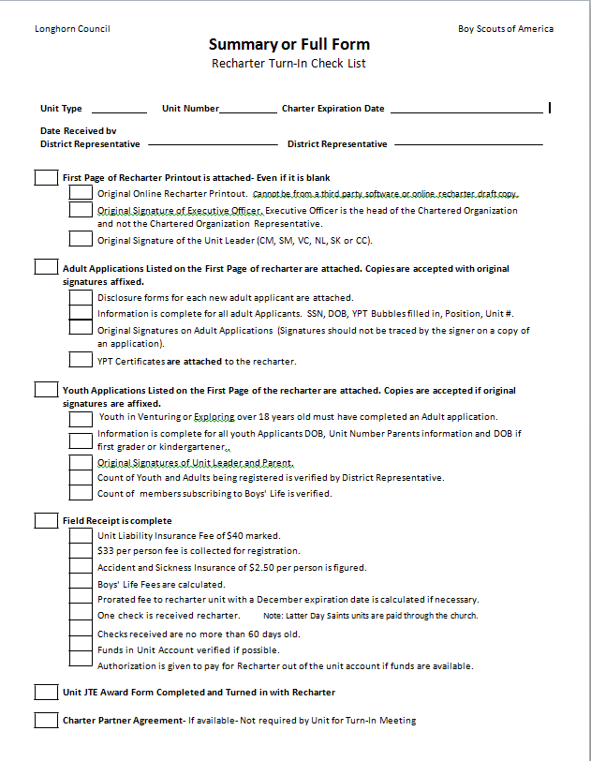
Recharter Check List

Slide 33
Journey to Excellence (JTE)
To evaluate the unit’s progress toward achieving the Journey to Excellence Performance Unit Recognition
To review the unit’s goals, successes, and vision for the coming year, including a succession plan for future key leadership.
To identify any areas of improvement—leadership, program, membership, youth and unit retention.
To determine any specific actions needing to be taken to assist with unit improvements and determine who will follow up on those actions

Slide 34
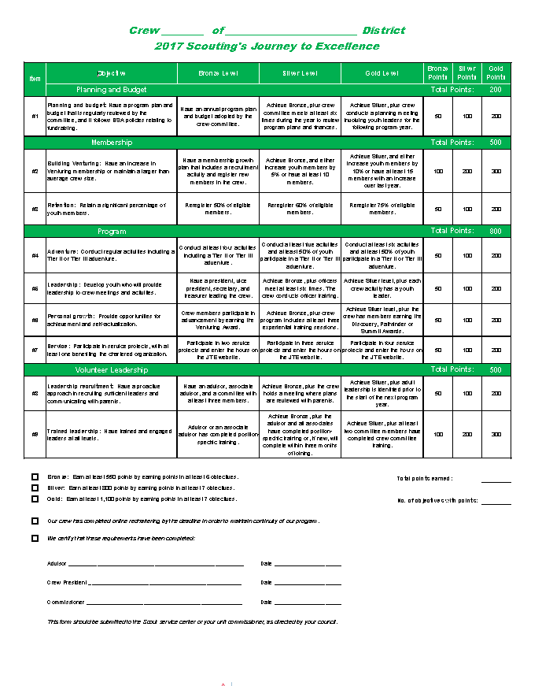
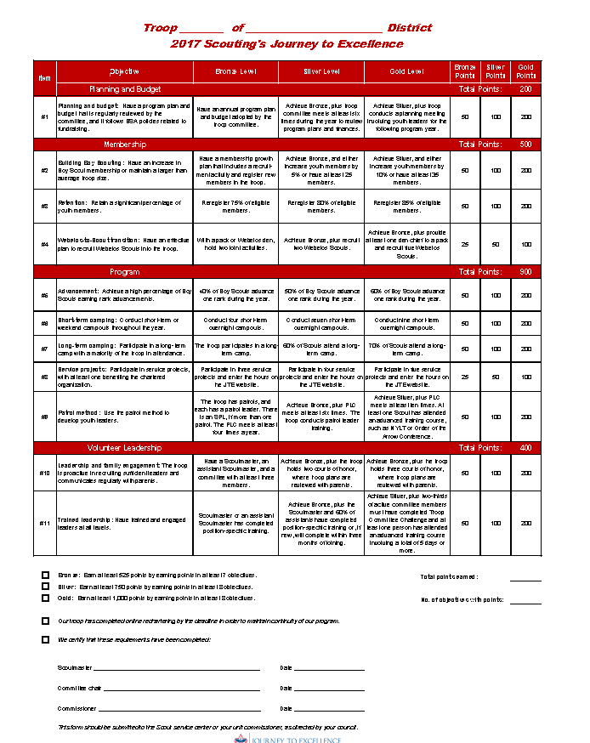
JTE Unit Award Forms

Slide 35
Data Collection in the 21st Century
Digital collection of JTE form
Unit JTE data can be filed electronically using this link:
https://docs.google.com/forms/d/11SZA2C8OgO02c--eJHPKGQxofUsvvHr1KENiZjZSFeo/edit?usp=forms_home&ths=true

Slide 36
Data Collection in the 21st Century
Collect District Data such as:
New Member Coordinator
FOS Unit Champion
Scout Saver program
Summer Camp/Day Camp/Treks
Using the following electronic form
https://docs.google.com/forms/d/19APN9Cu3jsN5SuuhBMtpKifetwhxPsqXajgaNlUPv_Y/edit

Slide 37
Best Practices
Rechartering often held up by a few individuals who are slow to pay up.
Give a deadline for payment and proceed with recharter with those who paid on time.
Those who don’t pay may submit a new paper application with fees before 31 Dec without losing their membership.

Slide 38
Best Practices Continued
Alert all leaders that they must have the new YPT certification each year.
Hit the “Refresh” button before submitting the recharter to ensure online registrations that occurred after you started are captured and included in the recharter process.

Slide 39
Best Practices Continued
For those who will be a MULTIPLE on your charter, identify the unit where they are paying their fees.

Slide 40
Questions?

Slide 41
Call 817-614-2340 or email james.goreham@gmail.com
Remember your Unit Commissioner, like the government, is there for you if you need help.

Slide 42
Thank you for Coming

