Slide 1

Unit & Member Renewal
September 11, 2024
Notes:
Welcome everyone... The race is on to RENEW!
Let’s get started.

Slide 2
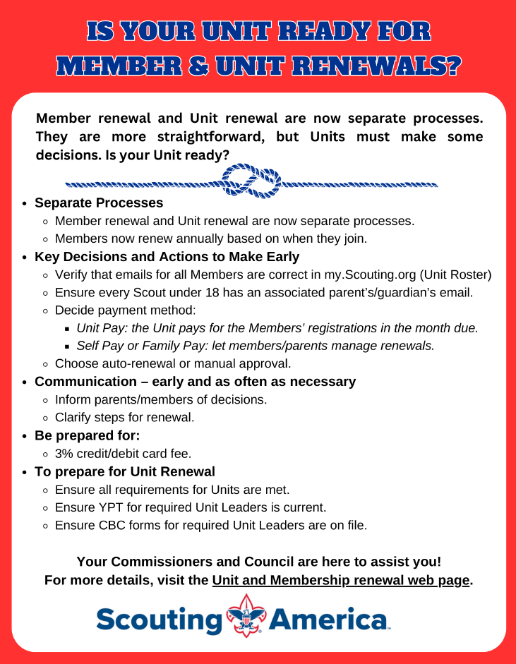
Is your Unit ready for member and unit renewal?
All Unit Key 3 Leaders should have received this flyer.
Notes:
This Member Renewal flyer is a good communication piece and should have been sent to all Unit Key 3 leaders.

Slide 3
Unit Renewal Process
The recharter process has been replaced and the units will renew on an annual basis through the My.Scouting tool in the Organization manager.
Notes:
Recharter is now Unit Renewal. Units will renew on an annual basis through the Organizational Manager in my.Scouting.

Slide 4
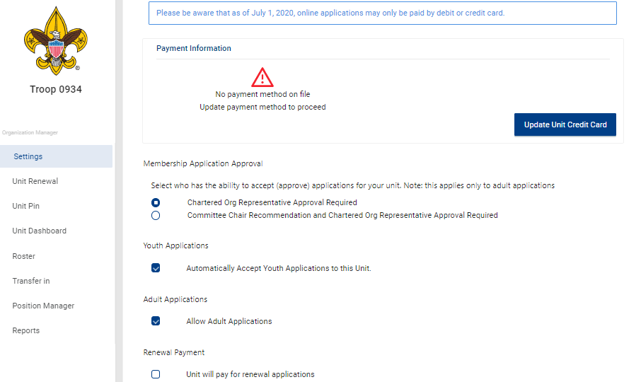
Recharter Renewal
No additional approval
COR/Delagate Approval
Notes:
Update Unit settings in Organization Manager.
You can enter a credit card to be used for payments if you wish.
Set youth applications to be approved automatically.
Allow Adult applications.

Slide 5

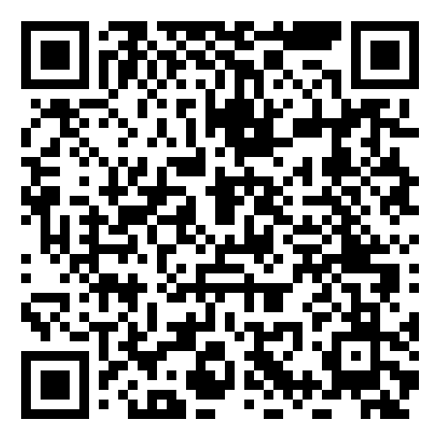
Key Items to Remember
Renews units – not members
Start 2 months before expiration
Two-month lapse period
Pre-check for validation issues
Check leadership positions
Credit/Debit card, ACH
Delay in accepting Adult Leaders
Notes:
Remember: The unit renewal process renews units, NOT members.

Slide 6
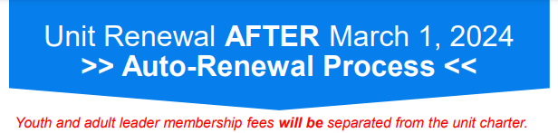
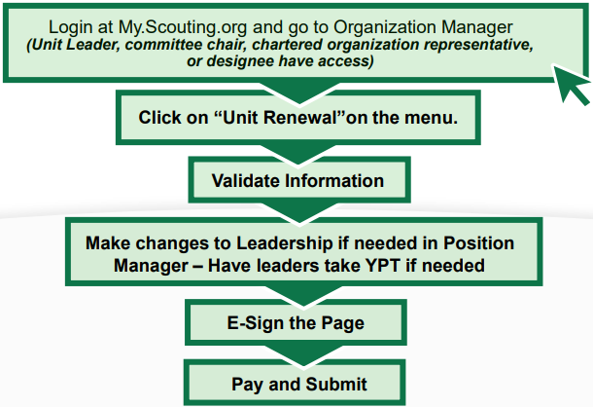
Unit Renewal is strikingly easy and takes 5 clicks
Notes:
Unit Renewal takes 5 clicks. It’s strikingly easy and quick.
So, what should units do?

Slide 7
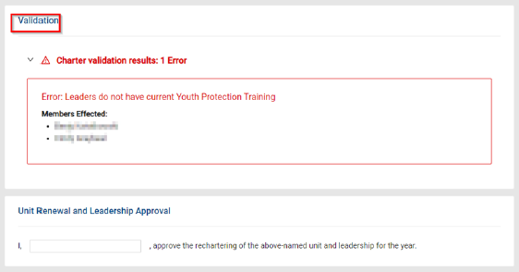
Unit Renewal – YPT Validation Issue
In this Validation Error example, there are two adults that have youth protection training that has expired.
Stop the renewal process and work with those adult leaders to make sure they get their youth protection updated.
Notes:
If there is a validation issue, it will show and stop the unit from continuing to renew.
The most common validation issue is the youth protection training dates for adult leadership, in this example you can see that there are two adults that have youth protection training that has expired. At that point, the unit would stop the renewal process and work with those adult leaders to make sure they get their youth protection updated.

Slide 8
Unit Renewal - Validation Requirements
Unit does not have required number of leadership positions
Leaders do not have current Youth Protection Training
Leaders are less than 18 years old
Leaders do not have completed CBC Authorizations
Adults do not have SSN
A warning message will not stop the renewal process. Example, having over 100 Scouts.
In Scouting America, volunteers are required to complete youth protection training every two years. In the Longhorn Council, we ask that all volunteers are current on their Youth Protection Training and up to date for the entire duration of their year-round registration. This means if you’re registered for the year, you must stay current with your training. If your training lapses, your membership will be suspended until you complete the training again. It’s important to keep this in mind to ensure that we’re all doing our part to protect our youth and maintain our roles in scouting!
Notes:
Let’s review the unit renewal validations:
• The unit must have the required number of leadership in the right positions
• The leadership must have the youth protection training current
• No leaders can be under the age of 18
• The system is also validating whether leaders have a completed criminal background check authorization form and it’s on file
• We also validate if the unit has any adults that do not have a Social Security number.
YPT Note:
In Scouting America, volunteers are required to complete youth protection training every two years. In the Longhorn Council, we ask that all volunteers are current on their Youth Protection Training is up to date for the entire duration of their year-round registration. This means if you’re registered for the year, you must stay current with your training. If your training lapses, your membership will be suspended until you complete the training again. It’s really important to keep this in mind to ensure that we’re all doing our part to protect our youth and maintain our roles in scouting!

Slide 9
Youth Protection Training Q&A
Q: Our council requires YPT to be taken annually. Will we be able to set up auto renewal and have the system verify that YPT is valid for the entire year?
A: The system will not have that functionality.
Q: If a leaders YPT is good on the date of processing the unit, but expires before the membership renewal date, will there be a flag and/or report to allow councils to continue to closely monitor YPT?
A: YPT will report as it does today, all adults are required to have current YPT on the day of processing to renew.
Q: The unit is struggling to renew (the $100 fee) because there are leaders that have expired YPT. Only the COR can change positions. How do we navigate this?
A: If leaders that have expired YPT are holding up the unit from renewing, you can suspend those adults to let the unit go through and renew. Then unsuspend them once they have renewed their YPT.
Q: Would setting the system to not allow units to auto renew prevent units from bypassing the council’s requirement of annual YPT? Would that be the best way to handle it?
A: The council setting to allow a unit to “Auto accept” the renewal does not turn off any auto renewal feature, the members can still renew.
Notes:
Just a few Youth Protection Training questions and answers that have been submitted.

Slide 10
Unit Renewal
Starting 60-days before the unit expiry date. Scroll down and click the “Unit Renewal” tab.
The validation process will run and check unit leadership, current youth protection training dates, background checks and other unit related validations.
Notes:
Two months prior to your unit’s renewal, Unit Key 3 Leaders will go to Organization Manager, in My.Scouting, and locate the tool called Unit Renewal. When the unit opens or clicks on unit renewal, the validation process will run. The validation process looks at whether the unit leadership is correct, adults have current YPT dates and other unit related validations.

Slide 11
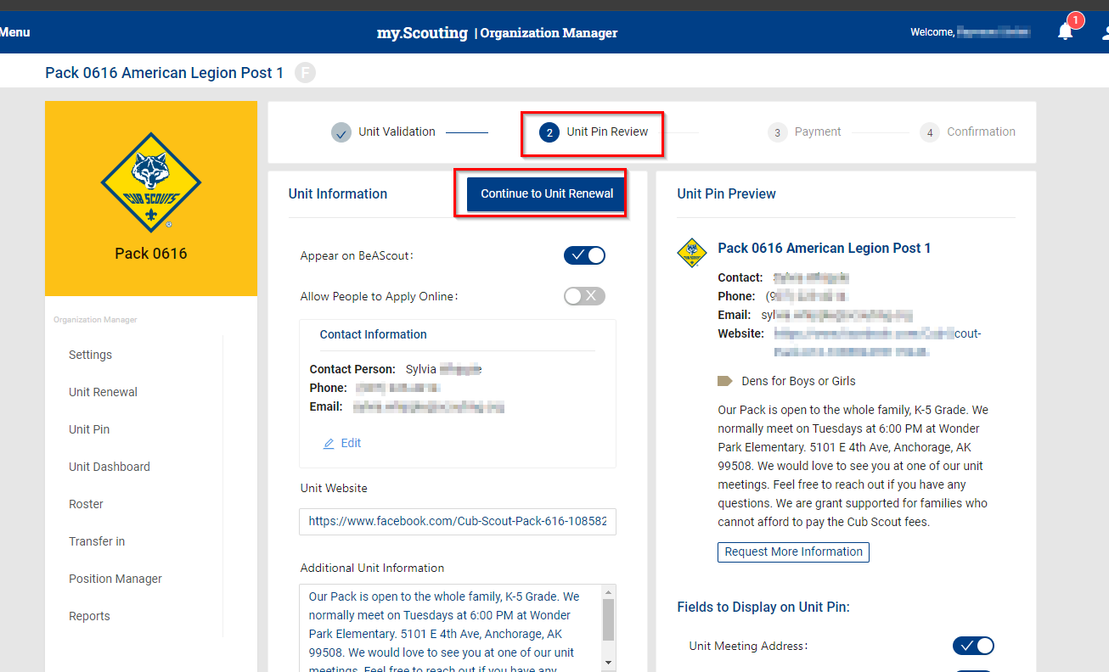
Unit Pin Review
Units will need to review their BeAScout Pins as part of the unit Renewal process.
Review leaders name, meeting times, meeting location, correct address and other content.
Notes:
After the validation process, you will be asked to review the Unit Pin. Confirm that your Unit Pin is active. When reviewing your Unit Pin, take this opportunity to verify leader names, meeting times, meeting location and address as well other information you may have listed.

Slide 12
Unit Renewal - Leader Approval
Notes:
After the validation is completed, corrections or changes should be made, if needed. When the Unit Key Leaders logs back into this app, the person completing this form will enter their name, as approving the unit renewal.
Click next step and make payment and complete the process online or
Click and print and deliver to your council office with payment.

Slide 13
Print a Copy
Sample of what the printed copy looks like. You can also create a PDF copy and email it.
Notes:
This is a sample of what the printed version of the unit renewal looks like.
It provides the information for the unit to take to the council office. It also provides space for a wet signature if needed.
We're asking this be done before the 15th of the month.

Slide 14
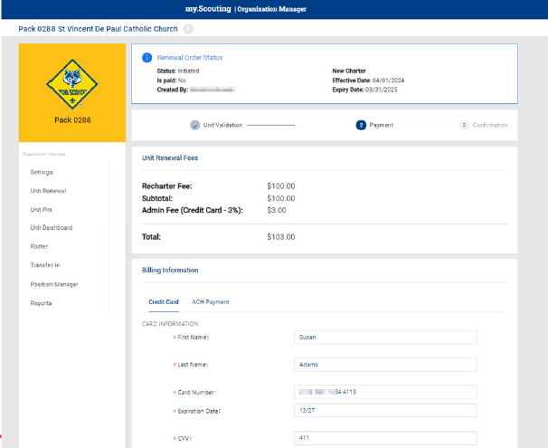
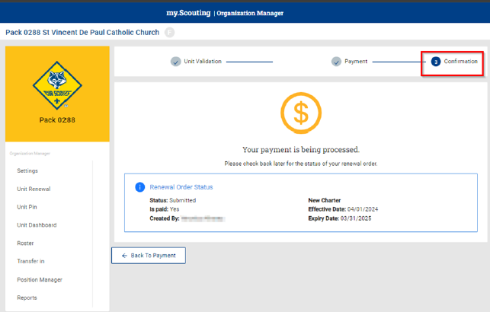
Fees recap at top of the screen shows amount to pay. $100 unit renewal fee + 3% admin fee.
Payment processing is shown on the screen
$100.00
3% admin fee
$103.00
Notes:
If a unit chooses to pay online, this recap at the top of the screen will show the fees that are about to be paid. It's the $100 unit renewal fee along with the 3% administration fee.
Once payment is made, confirmation is shown on the screen and that remains there until the next year when it is time for the unit to renew.

Slide 15
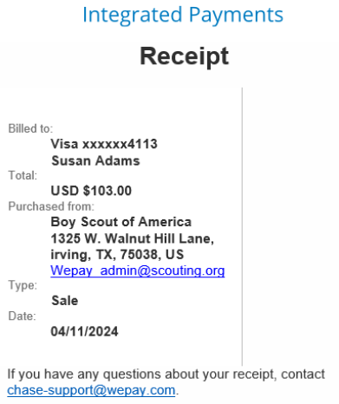
Payment submitted, paid & confirmed
Payer receives an e-mail receipt
Notes:
The payment confirmation also shows at the top of the renewal page once the unit has made the payment.
The payer will also receive an e-mail receipt in case they need to turn it into the unit to get reimbursed for making the payment.

Slide 16
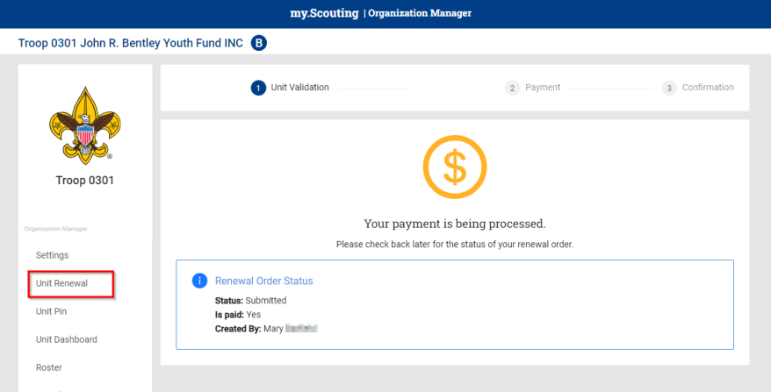
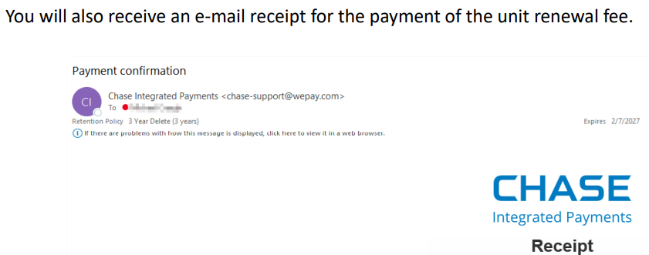
Unit Renewal

Slide 17
Paperwork
CPA – Charter Partner Agreement Facilities Use Agreement
Needs to be done annually
Notes:
Each year, the CPA needs to be renewed. If the CO sponsors multiple units, communicate with the other units as to who will get the CPA done.
If your unit is meeting at a location other than the CO, a Facilities Use Agreement needs to be filled out.

Slide 18

Notes:
There are three different processes that can be used to complete a member’s renewal. GO TO NEXT SLIDE.
Unit Pay: The unit pays for members’ registrations when due, or
Self Pay or Family Pay: Let members/parents manage renewals, or
Unit pays for some while families pay for others

Slide 19
Key Decisions for Units
Choose a member renewal plan:
    Unit Pay: The unit pays for members’ registrations when due, or
    Self Pay or Family Pay: Let members/parents manage renewals, or
    Unit pay for some while family pay for others
Choose auto or manual approval of adults
    Sidebar: These adults were approved when they joined the unit
Notes:
Units have some decisions to make as early as possible.
First, they must choose how they are going to make sure their members renew. There are 3 options:
Unit Pay: The unit pays for members’ registrations when due, or
Self Pay or Family Pay: Let members/parents manage renewals, or
Unit pays for some while families pay for others – Hybrid version
Units also need to decide whether to manually approve adults or allow that to happen automatically.

Slide 20
Sample Email Delivered to Unit Key 3 Leaders
Continue to make sure that you have updated your my.scouting.org account with a good email address and a cell phone number.
These are the primary ways that National and Longhorn Council will be communicating with you regarding your membership renewal.
Dear Unit Key 3 Leaders,
Longhorn Council and the (insert your district name) are working on Membership and Unit Renewal for 2025.
The all-important question: will your Pack, Troop, Ship, Crew or Post be doing charter renewal in which the Unit Pays for the members registration in the month it is due? or will the Unit allow members to “Self-Pay | Family Pay” where the members/parents manage renewals themselves?
You will recall that the procedures for membership renewal have changed, and members are beginning to renew today. Even if the unit plans to Unit Pay or allow members to Self-Pay, ALL member email addresses (including youth emails) need to be updated in my.scouting. Send test emails to your members and correct undeliverable errors today.
As a Commissioner in your District, I am available to support you through the member renewal process. Please forward your questions to me and I will get you answers. When you have a moment, please read the attached flyers, and visit this page for additional Charter Renewal Resources. https://www.longhorncouncil.org/charter-renewal
Yours in Scouting,
NAME
BSA Position
Phone Number (cell)today
Email Address
Notes:
Included is a sample email that may have been sent by the District Commissioner to the Unit Key 3 Leaders. A quick reminder that units need to answer the all-important question: will the Unit Pay or will the member /family pay or will the unit use a combination of both?

Slide 21
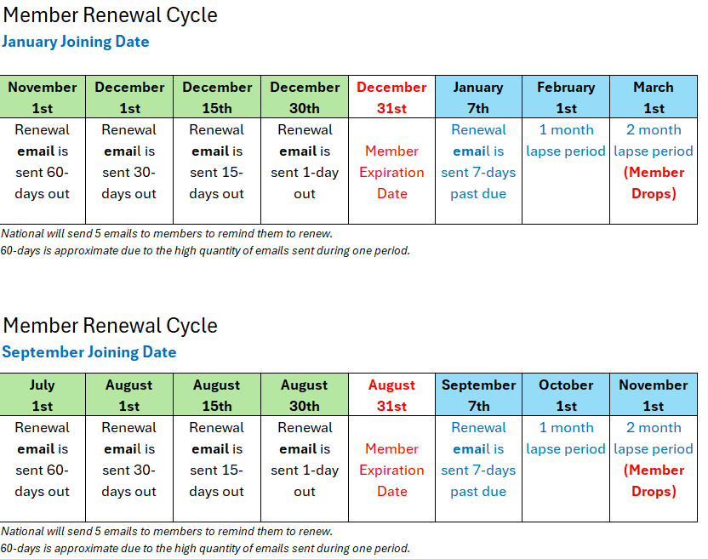
Member renewal will become a monthly process.
For some units it will be more frequent.
You don’t have to wait for an email to renew.
Notes:
Member Renewal Cycle for January & September Joining Date.
You don’t have to wait for an email to renew.
Do not procrastinate.
Eventually, your unit’s member renewal will become a monthly process.

Slide 22
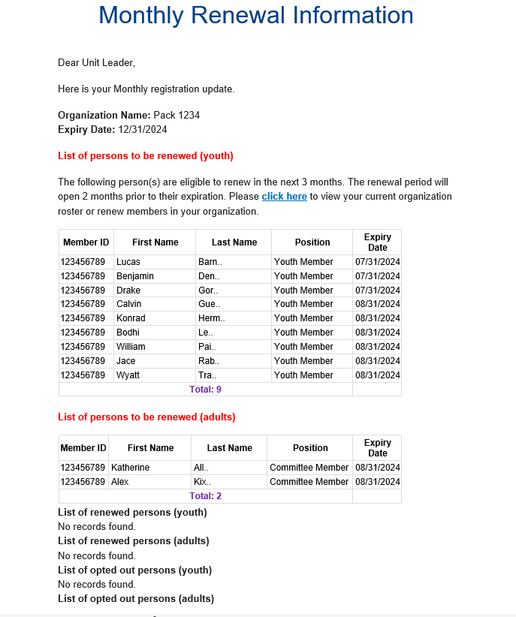
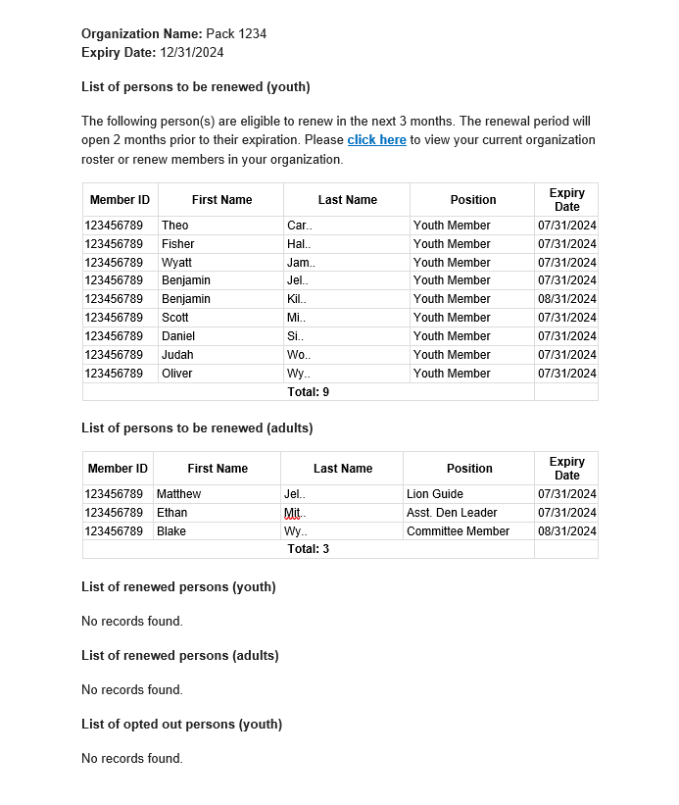
Monthly Renewal Info
Sample email sent by National to Unit Key-3
NOTE: “National is working to separate the
Youth email notice from the Leader email notice. It will be a few weeks, but soon these will be Targeted to the COR for Leaders and Unit Leaders /CC for Youth.“
- Michael Creagh
Notes:
National will send emails to the Key 3 Leaders. Here’s an example of two units showing a list of youth to be renewed as well as a list of adults renewing.
September 2024 email change:
National is working to separate the Youth email notice from the Leader email notice.
The change is likely to take place after Labor Day, 2024.
The emails will target the COR for Leader renewals and emails sent to Unit Leaders with Youth CC’d.

Slide 23
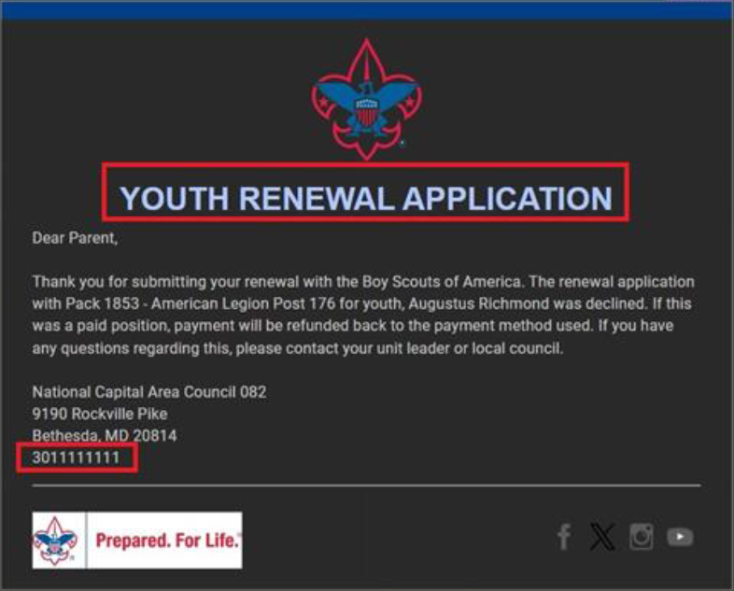


Youth Renewal Non- Acceptance
Sample email sent by National to a youth’s parents
Notes:
Example email from national to a youth’s parents notifying them that the renewal application was not accepted.

Slide 24
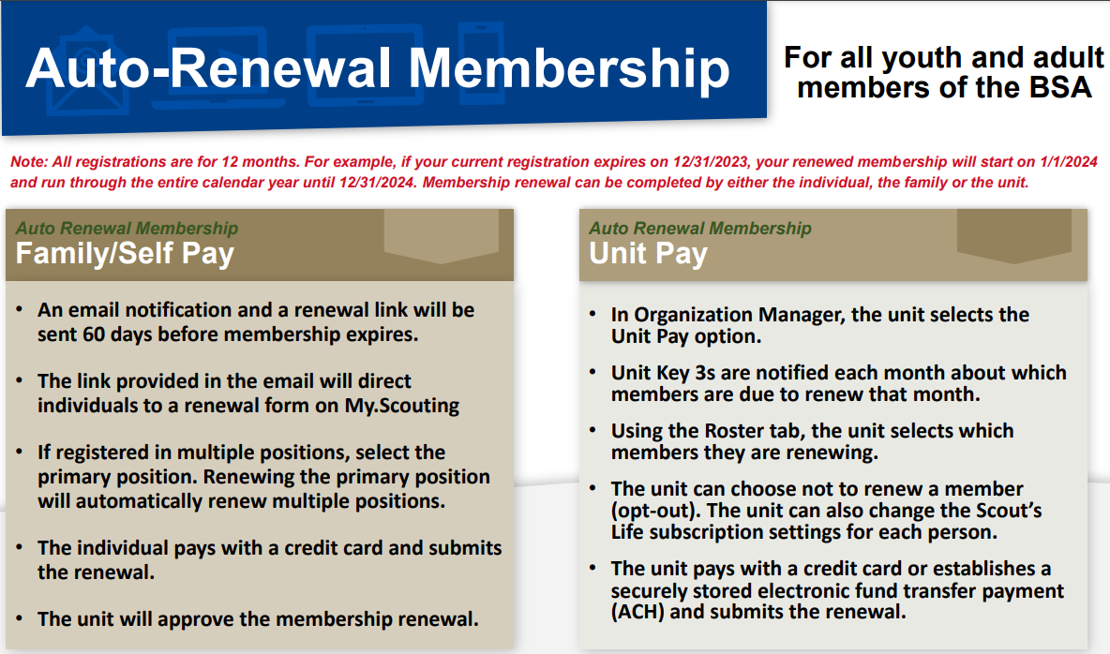



Combination of Unit pay and Family Pay
Notes:
Another Reminder:
There are three (3) methods for members to renew.
Unit Pay: The unit pays for members’ registrations when due, or
Self Pay or Family Pay: Let members/parents manage renewals, or
Unit pays for some while families pay for others

Slide 25
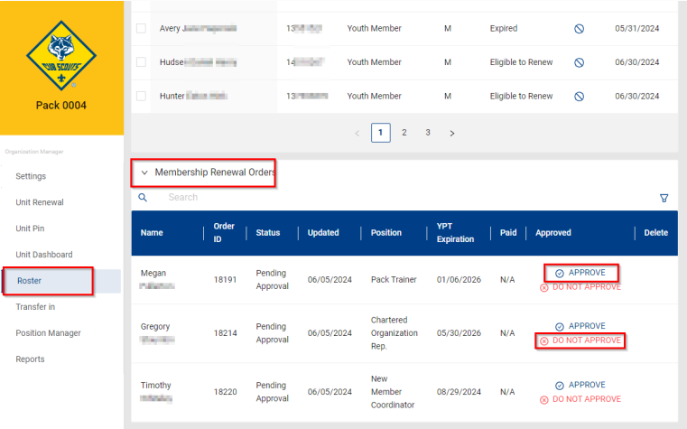
Member Approval
NOTE: Do not approve will automatically issue a refund.

Slide 26
Member Approval
NOTE: Do not approve will automatically issue a refund.

Slide 27
Family or Self Paid Renewal
When the Family or Individual Chooses to pay and submit the renewal
Notes:
In the next section, we will discuss family and individuals who choose to pay and submit the renewal themselves.

Slide 28
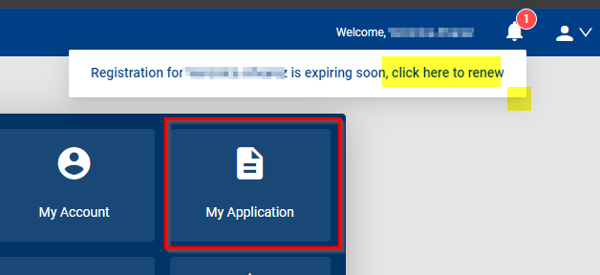
Annual Member Renewal Has Begun
Notes:
An e-mail will be sent two months (60 days) before your registration expires. Reminder, there is also a “reminder notice” found in My.Scouting, as shown on the screen and there is also a reminder notice in “Scoutbook plus” showing you that you have a renewal with a link to take you to My.Scouting, where you can connect with your application and make your renewal.
Within My.Scouting there's a tab called “my applications” if you've never been here before, this is where all your registrations and your child’s registration plus any multiples you might have, are listed and where you make your renewal.

Slide 29
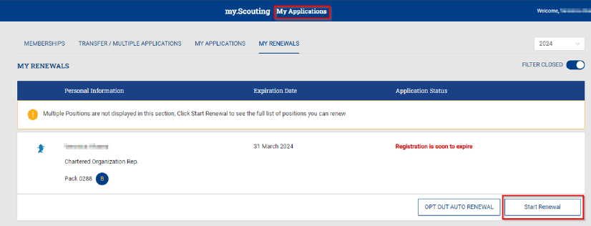
My Application – Click on “Start Renewal”
Notes:
In this example the adult has one registration as the COR Chartered Org Rep. All they need to do is click on the start renewal button and bring up any other registration details that need to be reviewed.

Slide 30
Current Memberships
The COR is the Primary person to be registered.
The COR is also a multiple (Committee Member) but we only want to pay in one position.
The Primary position must be selected and will default to previous years position.
Inactive changes can be made here.
Remove any positions that the person will not be renewing.
Notes:
We are now looking at the current membership that this person has, we can see the primary registration as the chartered Org Rep, but they all are also multipled as a committee member in the pack and also a chartered org Rep for the troop.
We only want to pay in one position so a primary position must be selected, and it will default to the previous year's primary position. If a change needs to be made, for example this person is no longer going to be active in the pack and only the troop that selection can be made at this time.
The person can also remove any positions that they will not be renewing for the next year then the next step is to go to payment.

Slide 31
Review Terms and Conditions.
Type in Your Name.
Click on “Go to Checkout Summary”
Notes:
You will be asked to review the terms and conditions and type in your name, then click on “Go to checkout summary”.

Slide 32
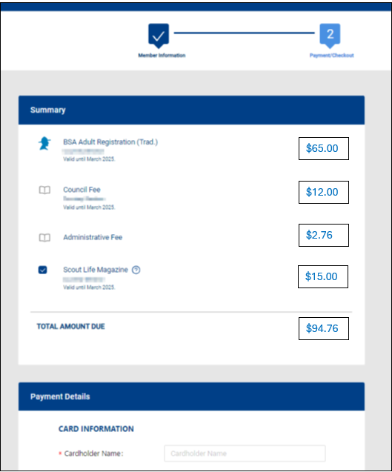
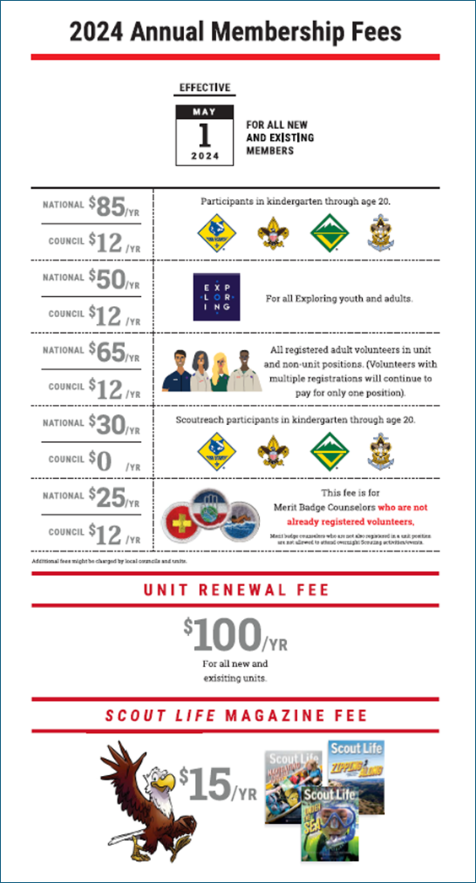
Review Summary of Expenses
Example:
$65 Adult fee
$12 Council fee
$2.76 (3% admin fee)
$15 Scouts life mag. fee
Total = $94.76
If correct, scroll down and enter your payment method.
Notes:
You are now presented the summary of the expenses, in this example, they are renewing as an adult, their council has a program fee, there is a 3% administration charge and this
person has selected Scouts Life magazine to renew. The total is $94.76. At this point you scroll down to enter your payment method.

Slide 33
Billing Information
Member address should be auto populated. Make changes if needed.
If everything is correct, Click on “Place Order”.
Payment is made and an email will be sent acknowledging the payment.
Notes:
The billing address is auto populated for the primary address you have on file, but you can change it too. You have the ability to restart the process completely if needed, but if everything is correct then you click ”Place Order” and the payment is made, an e-mail will be sent acknowledging the payment and you have renewed your registration in the Boy Scouts of America for another 12 months.

Slide 34
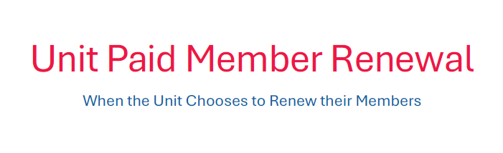
Notes:
How the unit can pay and renew membership using My.Scouting and the “Roster” tool. The unit can renew adults or youth members, that's entirely up to the unit.
Reminder: Member renewal will become a monthly process for most units.

Slide 35
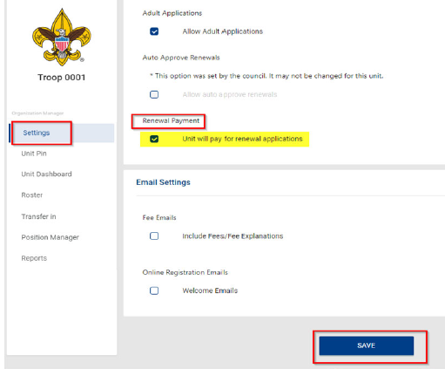
Unit Will Pay update:
The setting for “Unit Pay” on the unit settings page has not been working as originally intended.
Because of that, the option has been completely removed for now.
It will be added back at some point in the future when the process is functioning properly.
NOTE: “National has removed this button for now. Units can renew without checking this box.”
- Michael Creagh
Notes:
The “Unit Will Pay” for renewal applications check box has been removed temporarily.
When it is repaired:
If a unit chooses to make membership renewal payments, one of the unit “Key-3” will need to go to Organization Manager, and in the “settings” tab, there's an option to select the “Renewal Payment”, this will allow the unit to process renewals.

Slide 36
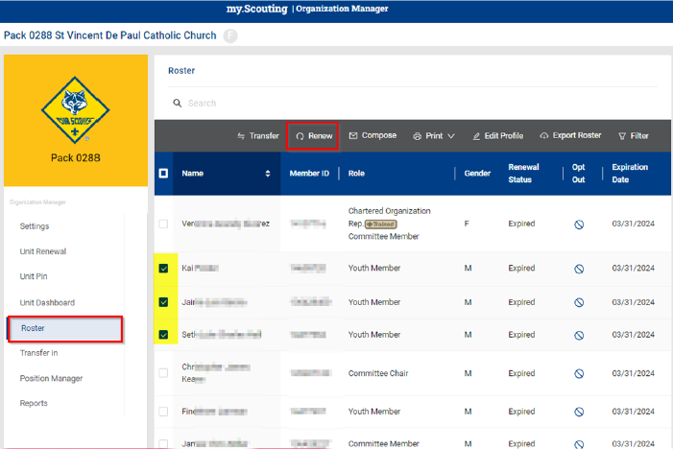
Organization Manager
New Roster Feature!
Unit will check the boxes on the far-left side of those members they want to renew.
Then click the renew button in the gray header at the top of the roster bar.
Example:
3 youth have been selected.
Notes:
In Organization Manager there is a new roster feature. It will be live within that 60-day window to renew registration.
The process is very simple. The unit checks the boxes on the far-left side for those members they want to renew and then click the renew button up in that Gray header, at the top of the roster bar.
In the sample, 3 youth have been selected.

Slide 37
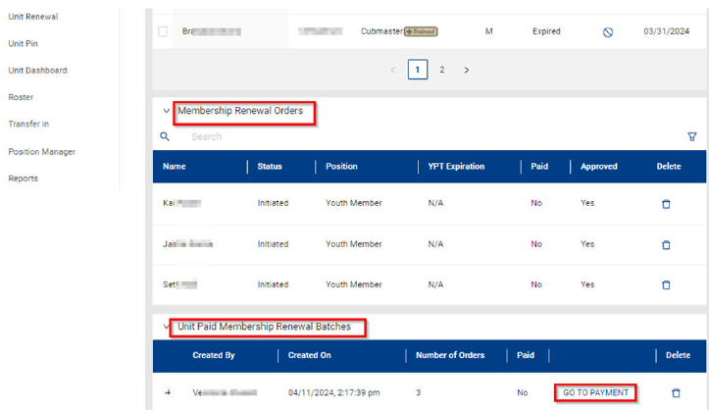
Membership Renew Order & Unit Paid Membership Renewal batch details
Example:
3 youth have been selected.
All youth are approved.
Click on “Go to Payment”.
Notes:
Once the “renew” tab is clicked, the bottom of the page opens to show the “Membership Renewal Order” details and the “Unit Paid Membership Renewal Batch” details. In our example you'll see the three youth are selected, looking at the “Batch” section on the bottom, they would click the “Go to Payment” tab to continue.

Slide 38
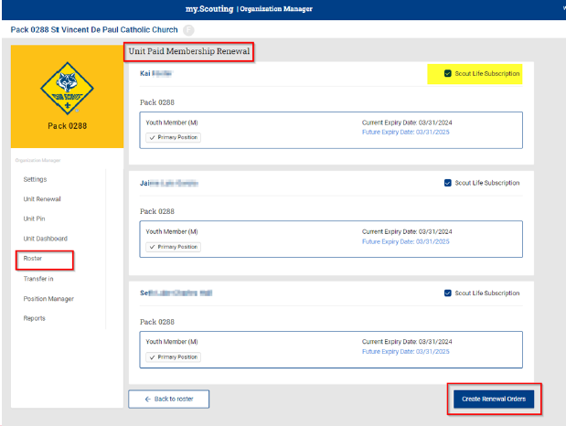
Unit Paid Membership Renewal Review & Edit
Example:
3 youth have been selected.
Primary position has been checked.
Scout Life Subscription has been added for two youth.
Click on “Create Renewal Order”.
Notes:
This brings us to a view of the membership selected and the option to make any edits such as Scout Life magazine subscription or whether this is a primary position.
When all those edits are corrected Click “Create Renewal Order”.

Slide 39
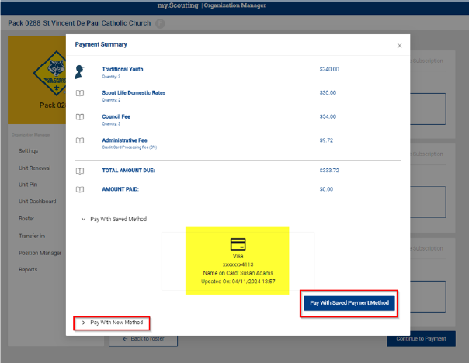
Payment Summary
Example:
3 youth have been selected.
2 youth are receiving a Scout Life Subscription.
The council program fee has been added. (if there is a council fee)
The admin fee has been added.
Total amount due is listed.
Click saved payment method.
Or click on payment method, credit card w/3% admin fee or ACH with $1 fee.
Notes:
The “Payment Summary” is now displayed, and we see we have our three youth, two with “Scout Life Magazine”, we have the council program fee and the administration charge of 3%.
This totals up and the unit have the ability to use a saved payment method such as the credit card that we just used to renew Susan, or you can add a new payment method. The units have an option to use a credit card or an ACH. The credit card charges the 3% administration fee the ACH charges a $1.00 fee.

Slide 40
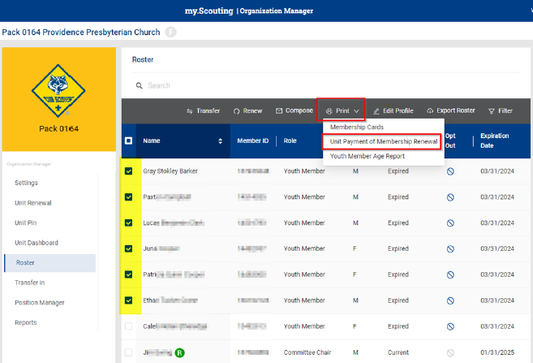
Print a Copy
Create a paper copy of the renewal order by selecting who you want to renew and going to the “print” option, on the menu bar at the top of the roster page called “Unit Payment of Membership Renewal.
* Reminder: the “R” in the green circle shows who has renewed already.
Notes:
The unit can print out a copy of the renewal order that they create by selecting who they want to renew and then under the “print” option up at the top of the roster page a choice called “Unit Payment of Membership Renewal” this is how the unit could create a paper copy to save for their unit records or take to the council office.
The circled green “R” shows members who have already renewed.

Slide 41
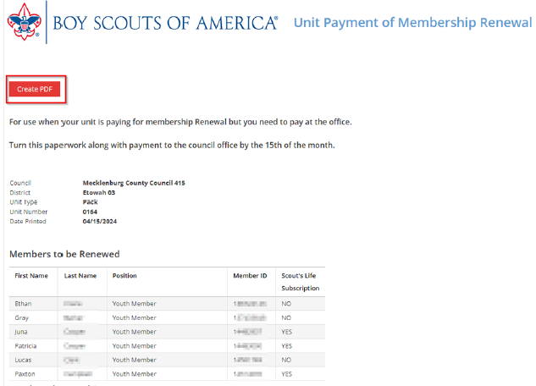
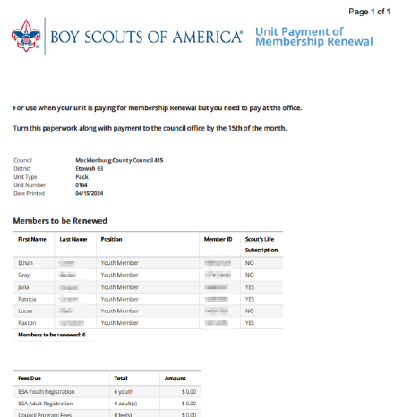
Create and Send
as a PDF
You will see an example of what you have created.
You can also export as a PDF and email if necessary.
Notes:
On the screen is a sample of what is created, this can be reviewed and if all is correct, then they can export it as a PDF file to send it to the council and make the payment. We want to give the unit as many opportunities to renew their membership as possible.

Slide 42
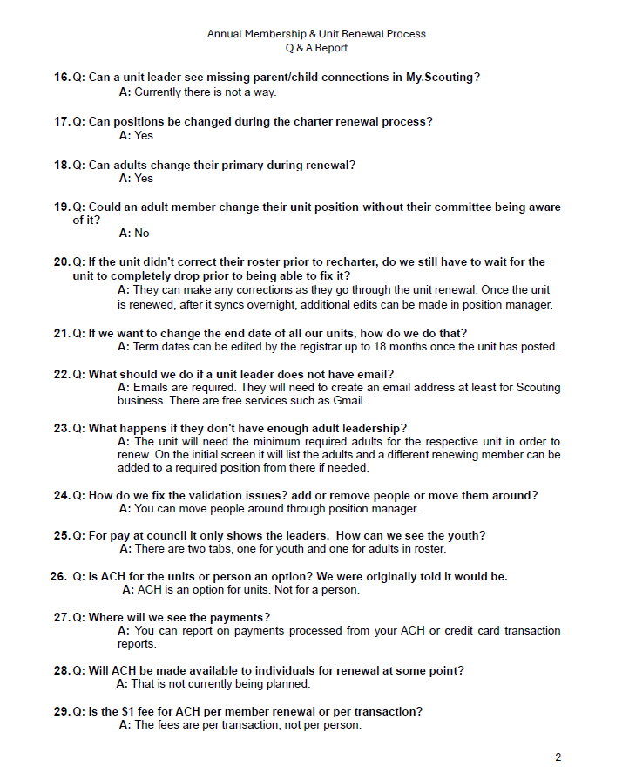
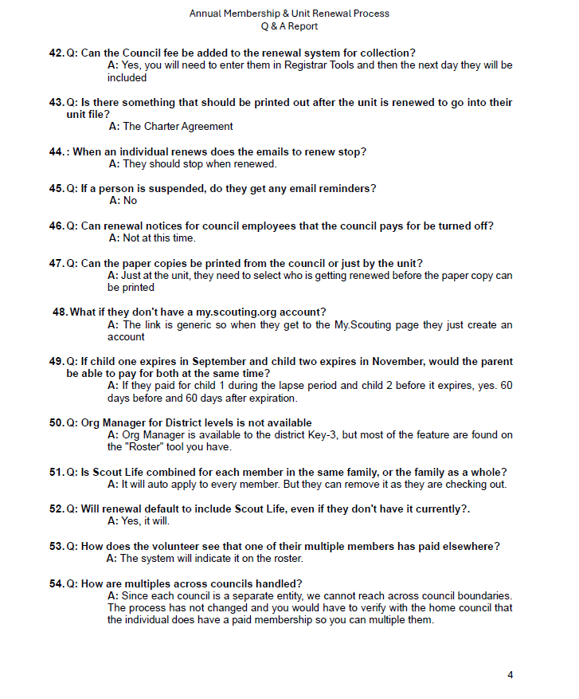
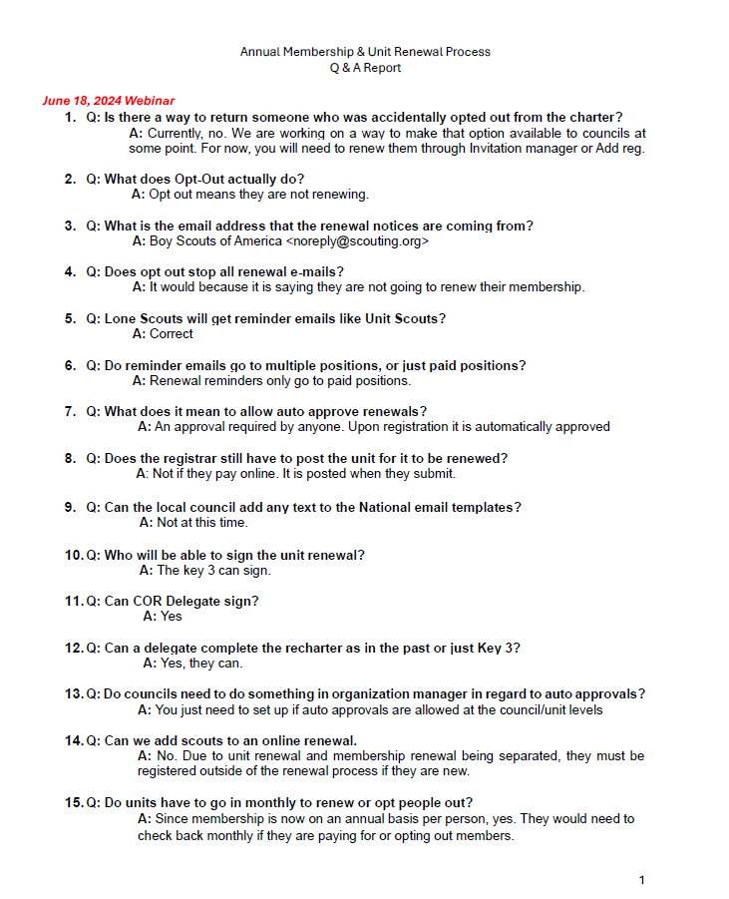
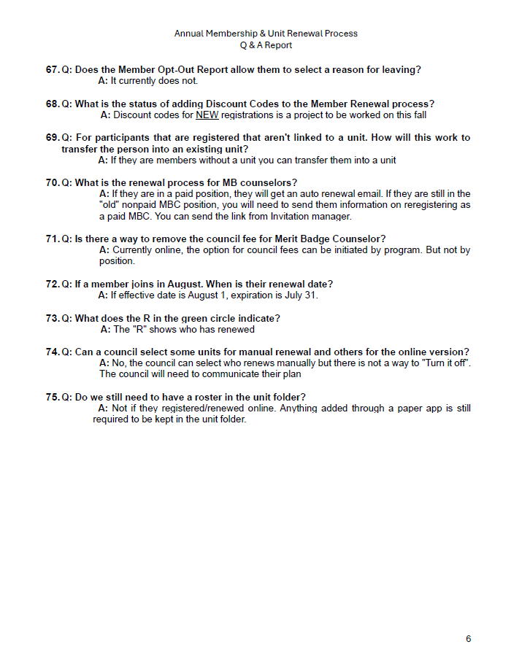
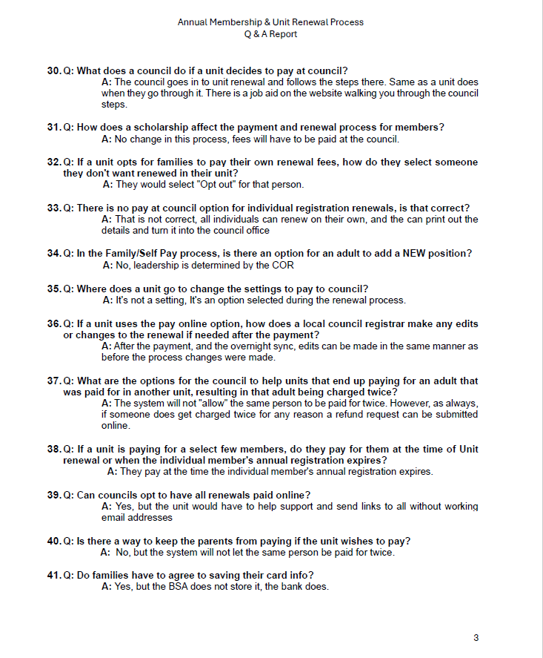
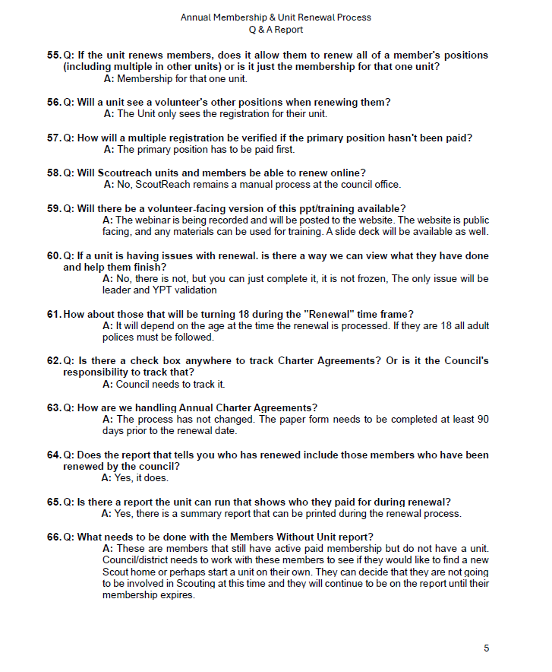
Q&A
Renewal Process as of June 18, 2024
Click Here
Notes:
Frequently asked Questions are added monthly to the National website. Check back to see more.

Slide 43
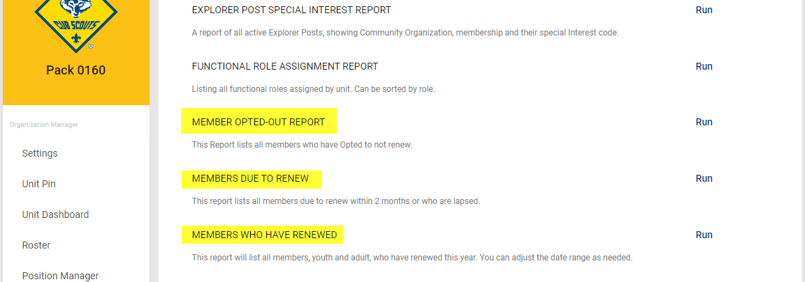
Helpful Reports – Organization Manager
Reporting
There are a number of reports that Commissioners and Unit Leaders can find in Organization Manager.
Examples:
Member Opted-Out
Members Due to Renew
Members Who Have Renewed
Notes:
There are a number of reports district and unit leaders can find in Organization Manager.
We are looking at the report section of Organization Manager for a Cub Scout Pack and you can see there are reports for “Members who have opted out”, Members Due to Renew”, and Members who have Renewed”, these reports are all available in Organization Manager at the Unit level, District level, and the Council level.

Slide 44
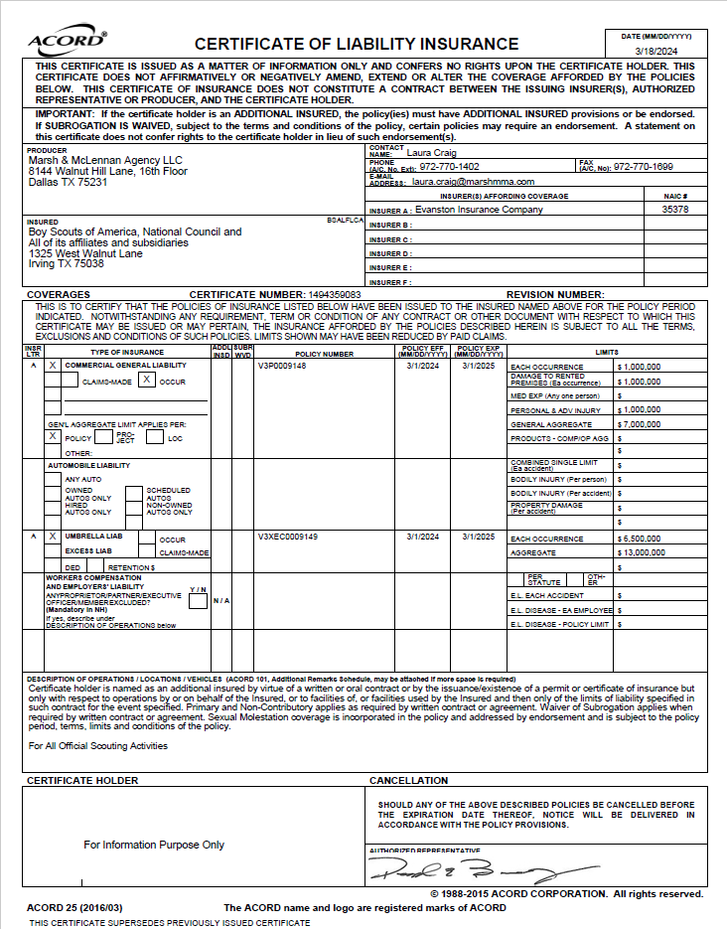
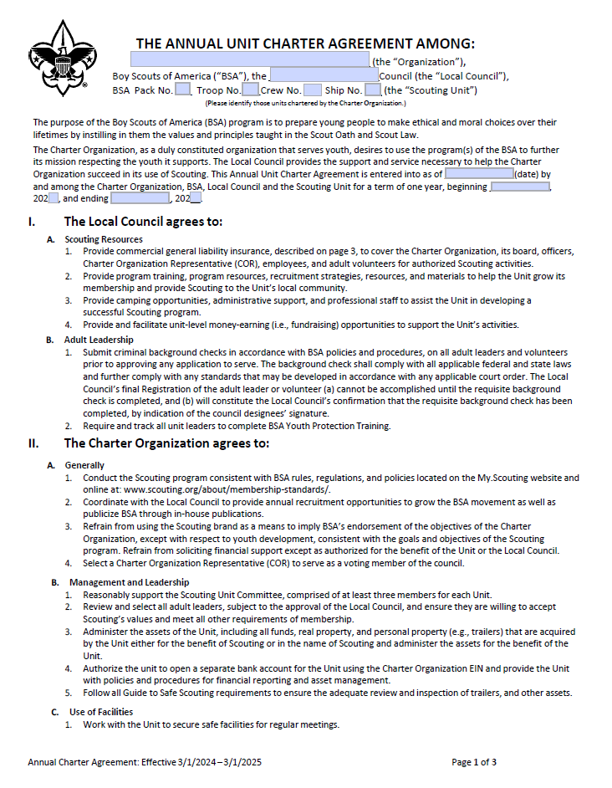
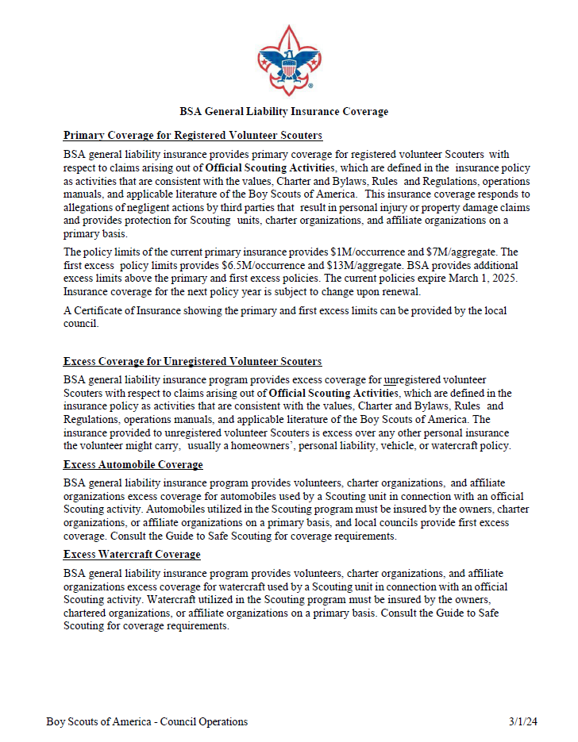
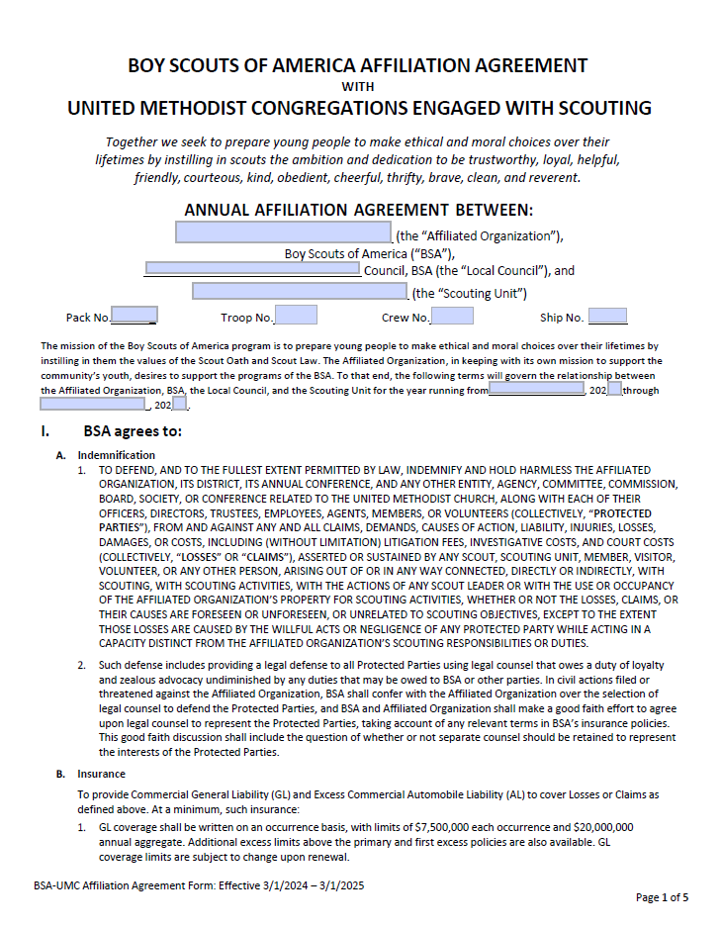
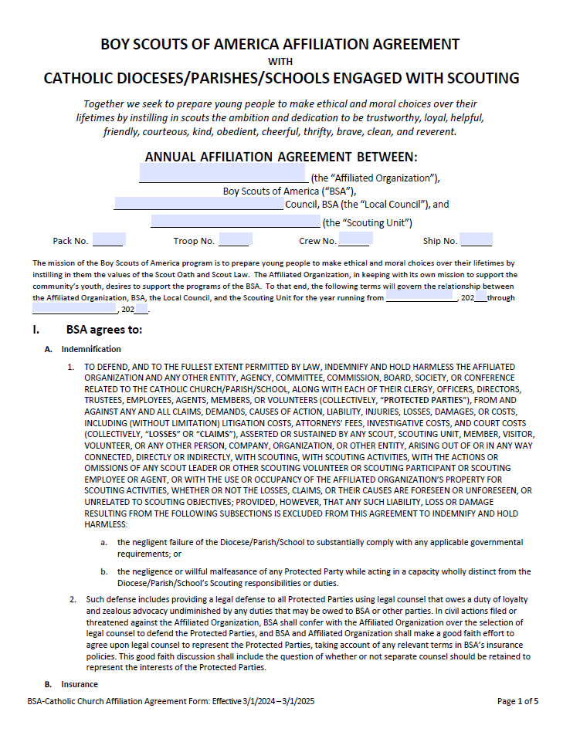
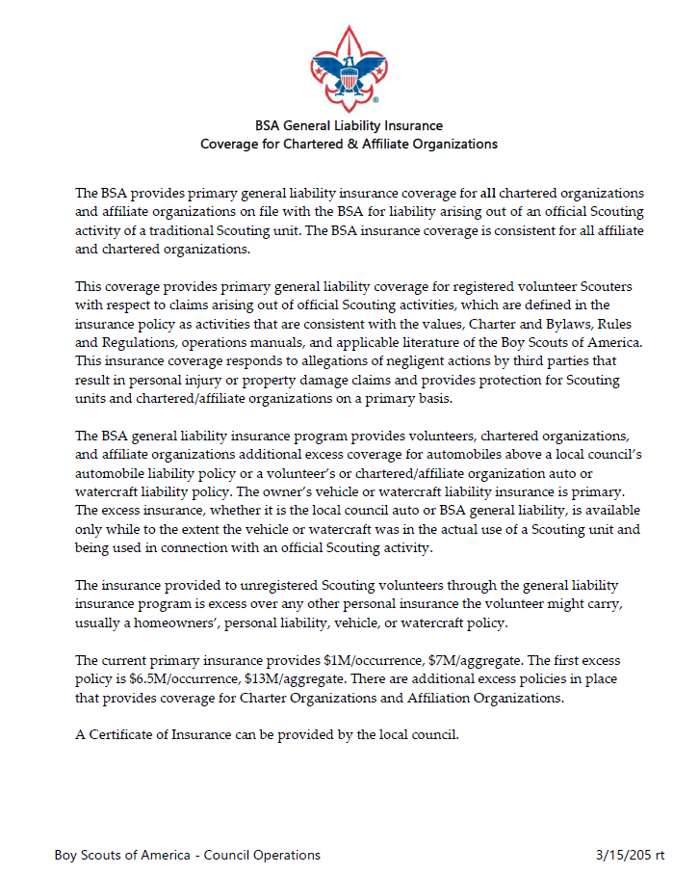
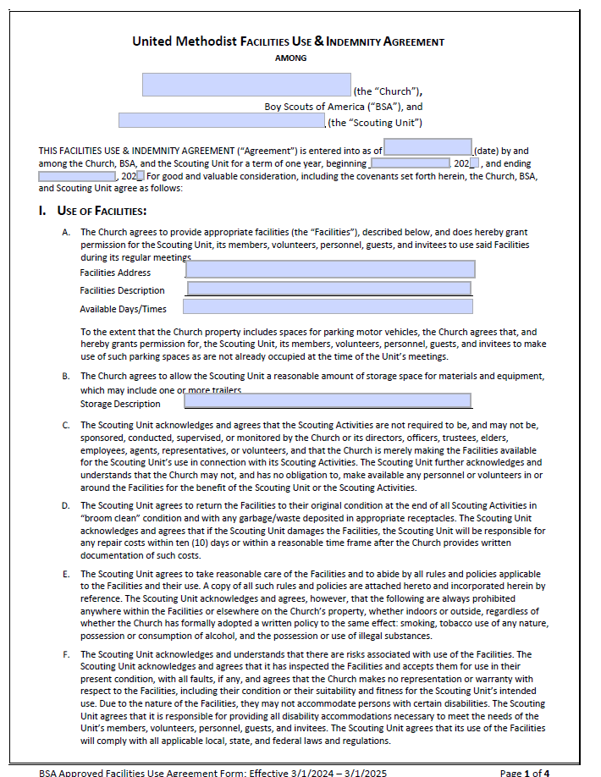
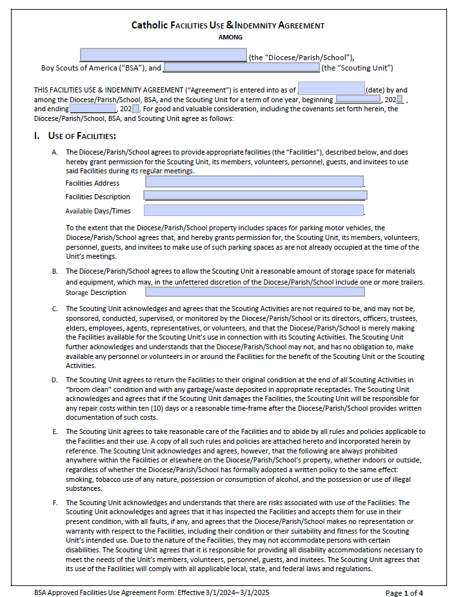
Charter Partner Agreements, Facility Use Agreements and BSA Insurance Info
Unit Leaders, after CPA-FUA forms are signed, turn them into your Unit Commissioner or District Commissioner. DC’s forward signed forms to Stacy Cummings, LHC Registrar.
Notes:
It is the responsibility of the Unit Key 3 Leaders to meet with the charter partner annually. In some cases, you will need a charter partner agreement, and a facility use agreement signed by the charter partner. After the documents are signed, forward them to your Unit Commissioner or district Commissioner. They will then forward to the Council Registrar.

Slide 45
Registration Updates
The frequency of emails going to key 3 reminding them to approve membership renewals has been updated. The emails are now going on Tuesday and Thursday only and are now a batch email vs an individual email per person.
Another change to the renewal approval reminder emails is that the email listing youth will only go to the unit leader and the Committee Chair and the email listing the adults will only go to the Chartered Organization Rep.
Notes:
The frequency of emails going to key 3 reminding them to approve membership renewals has been updated. The emails are now going on Tuesday and Thursday only and are now a batch email vs an individual email per person. So, one email will list all that are waiting to be approved instead of multiple emails.
Another change to the renewal approval reminder emails is that the email listing youth will only go to the unit leader and the Committee Chair and the email listing the adults will only go to the Chartered Organization Rep. As a reminder, Unit Key-3 get emails for leads on Tuesday and Thursday and Pending membership Applications on Wednesday and Friday.

Slide 46
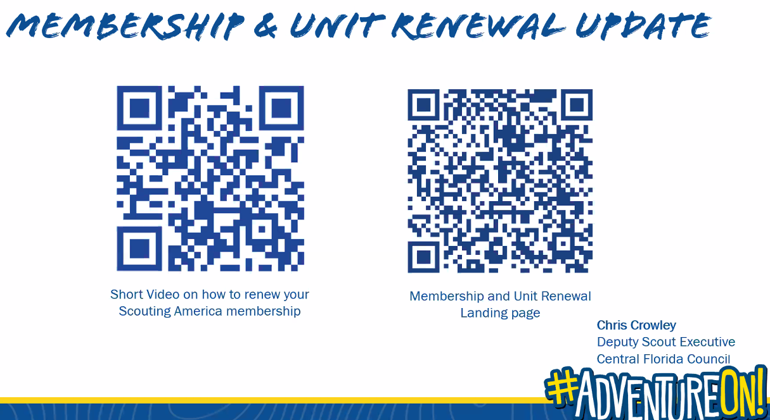
Member Renewal Video & Unit Renewal Landing Page
Member and Unit Renewal Resources
https://www.scouting.org/resources/unit-and-membership-renewal/
2025 Unit & Member Renewal Resources
Unit and Membership Renewal
Recharter Changes – 2-27-24 Webinar
Cub Chat, Member Renewal & Pack Recharter
Scouting Forums, a place to discuss recharter
Charter Renewal FAQ
BSA Registration and Renewal Job Aid
Unit Pay for Member Renewal Job Aid
Unit Renewal Guide Job Aid
Annual Charter Partner Agreement Form
BSA Adult Application
Notes:
There are plenty of resources found on the National website found here. https://www.scouting.org/resources/unit-and-membership-renewal/

Slide 47
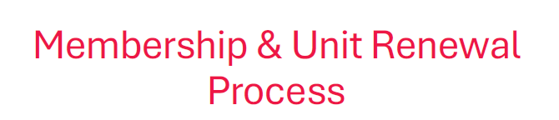
https://www.scouting.org/resources/unit-and-membership-renewal/
James Goreham, District Commissioner (817) 614-2340 or James.Goreham@gmail.com
Hector Reyes, Assistant Council Commissioner (415) 990-4386 or HectorReyesBSA@gmail.com
John Hearrell, Council Commissioner (817) 995-7715 or jhearrell@nase.org
Notes:
Who Ya Gonna Call?
Unit Commissioner
District Commissioner
Assistant Council Commissioner for Unit & Membership Renewal
Council Commissioner
Registrar

Slide 48
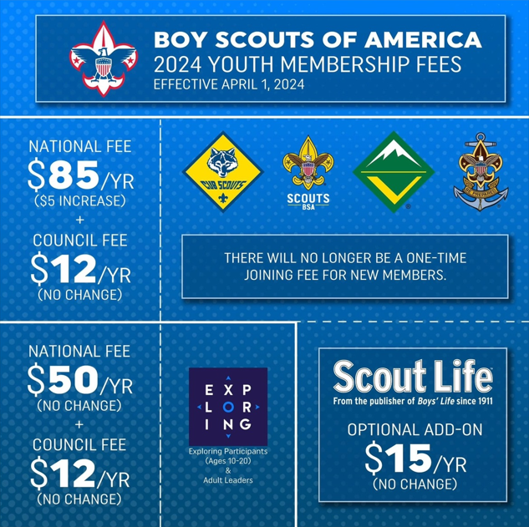
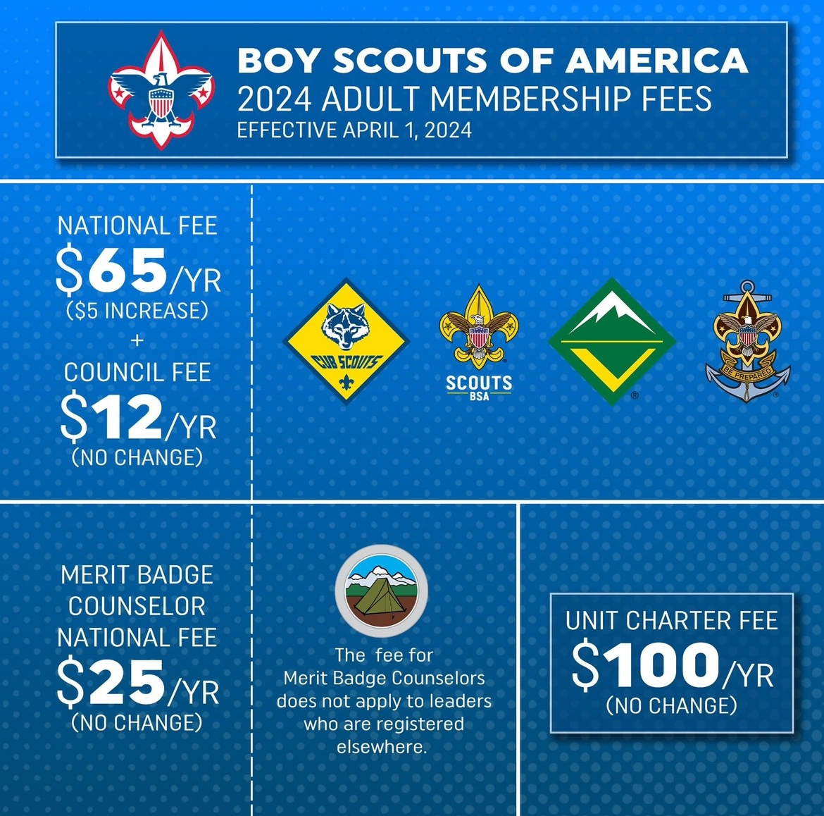
Youth and Adult Membership Fees
Notes:
Alternate Member Fee infographics.

Slide 49
Sample Email From DC’s to LHC Members (starting Nov 1, ’24)
Continue to make sure that you have updated your my.scouting.org account with a good email address and a cell phone number.
These are the primary ways that National and Longhorn Council will be communicating with you regarding your membership renewal.
Sample email below.
Good [afternoon][morning][evening]!
As the District Commissioner for the _________ District, I want to remind you that it’s time to renew your or your child’s membership in Scouting America. Please log in to https://my.scouting.org and click on the “My Application” button.
Check with your unit leaders to see if they will handle the renewal or if you need to do it.
On behalf of the _________ District and the Longhorn Council, I hope you and your child(ren) are enjoying Scouting. If not, please let me know so I can help.
If you have any questions about renewing, please contact your unit leaders. They should know who to ask if they don’t have the answer. You can also reply to this email.
Yours in Scouting,
__________ First, Last Name
__________ District Commissioner
__________ Phone & Email address
Notes:
Included is a sample email that may be sent by the District Commissioner to the LHC Members up for Renewal. A quick reminder that units need to answer the all-important question: will the Unit Pay or will the member /family pay or will the unit use a combination of both?

